Slide 1

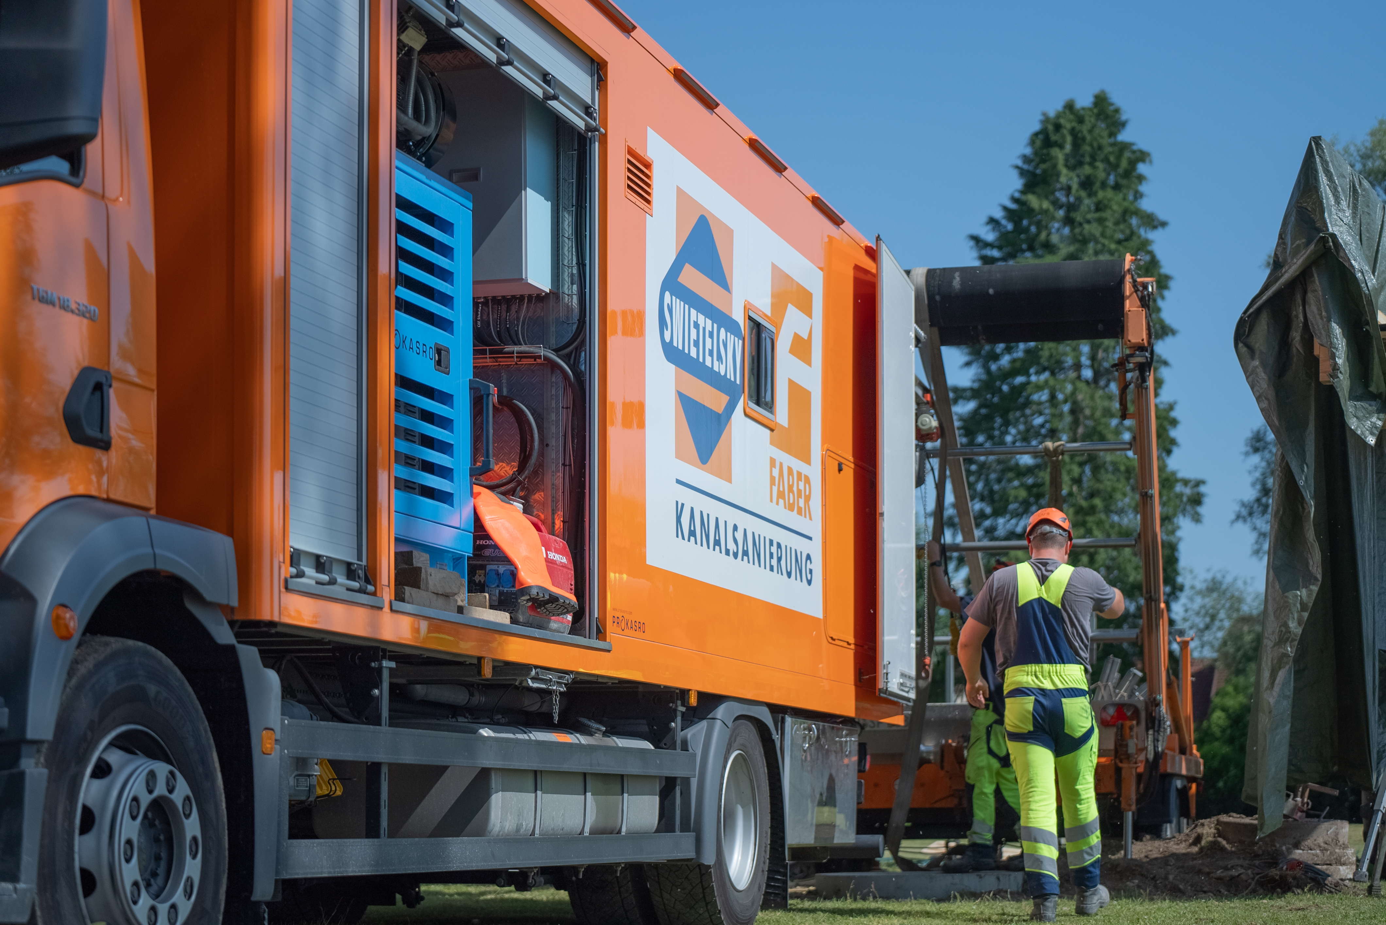
FUTURE NEEDS INNOVATION
The wide range of Pipe Rehabilitation Systems
swietelsky-faber.com

Slide 2
TABLE OF CONTENT
About us
Expertise & Services
Excellence & Recognition
Case Studies

Slide 3
ABOUT US
"Your partner in modern pipeline rehabilitation"
swietelsky-faber.com

Slide 4
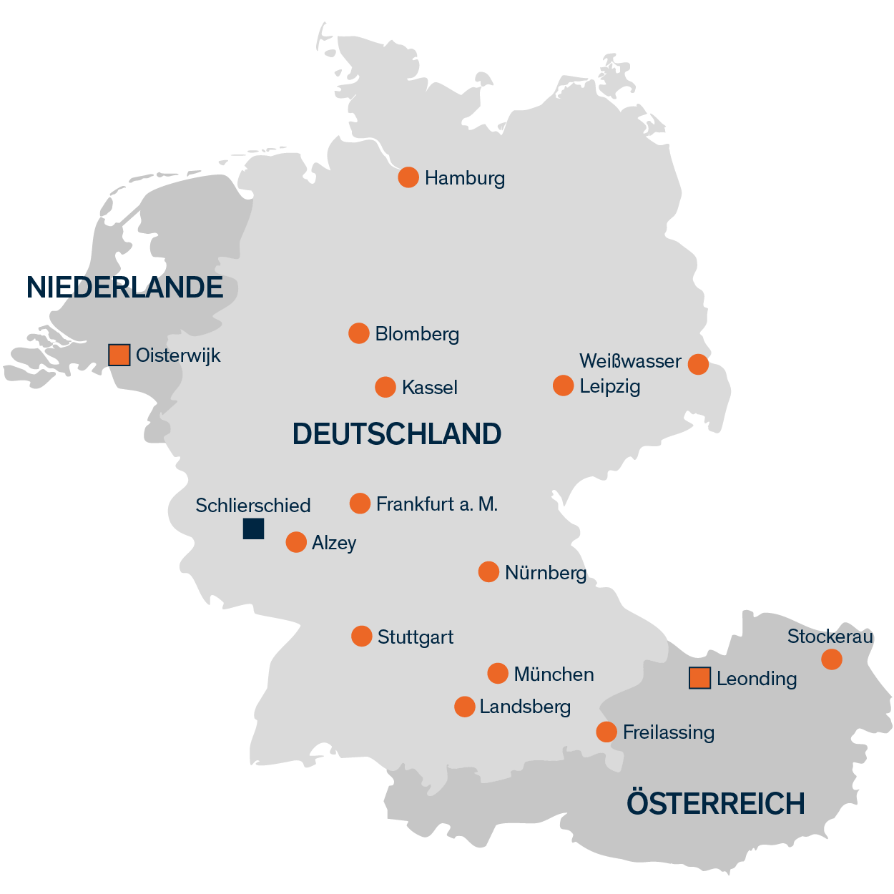

ABOUT US
Company Profil
Cooperation SWIETELSKY and EIFFAGE (Faber)
Founded 2001 Swietelsky-Faber GmbH
part of the corporate groups
SWIETELSKY and EIFFAGE
14 branches mit 350 employees

Slide 5
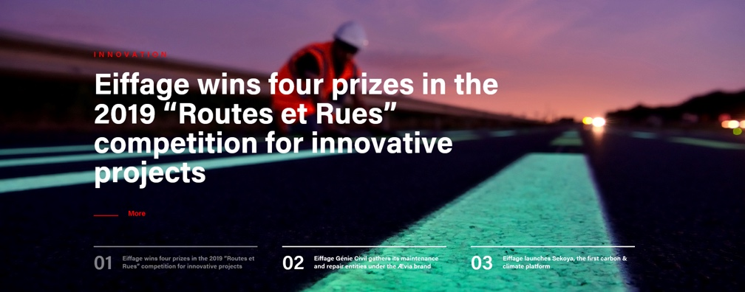


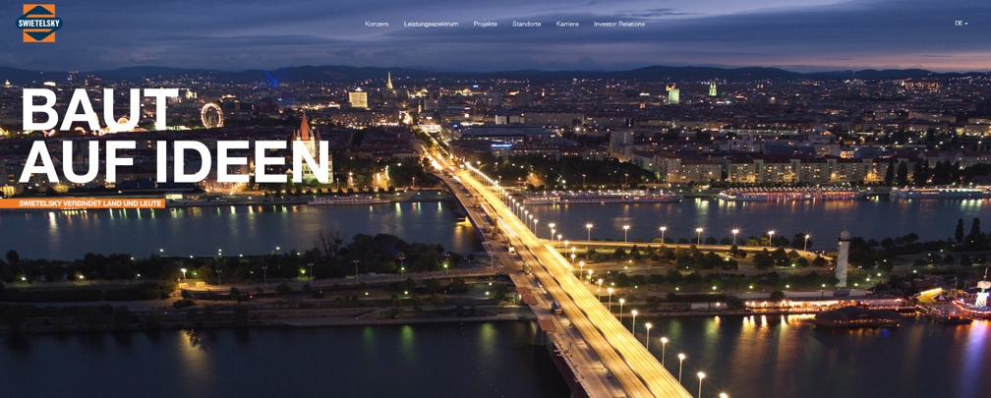
ABOUT US
Company Profil
Swietelsky-Faber is part of two globally active corporate groups: SWIETELSKY and EIFFAGE
EIFFAGE
78.200 employees
      21,8 billion € Turnover
      1,0 billion € Profit
SWIETELSKY
12.035 employees
      2,1 billion € Turnover
      0,2 billion € Profit
SHAREHOLDERS OF SWIETELSKY-FABER TOTAL
90.035 employees
      23,9 billion € Turnover
      1,2 billion € Profit

Slide 6
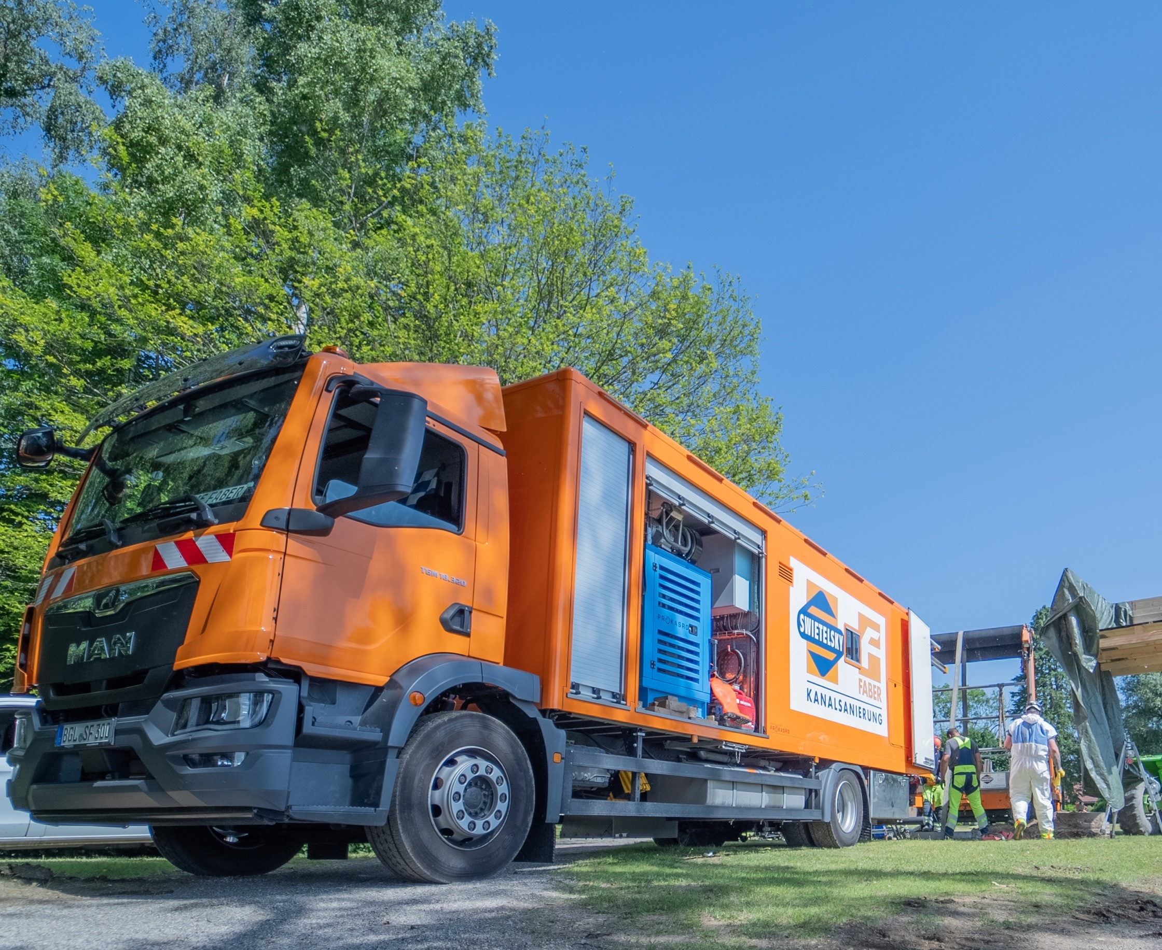
ALWAYS ON SITE
Locations in
Germany
Netherlands
Austria
swietelsky-faber.com

Slide 7
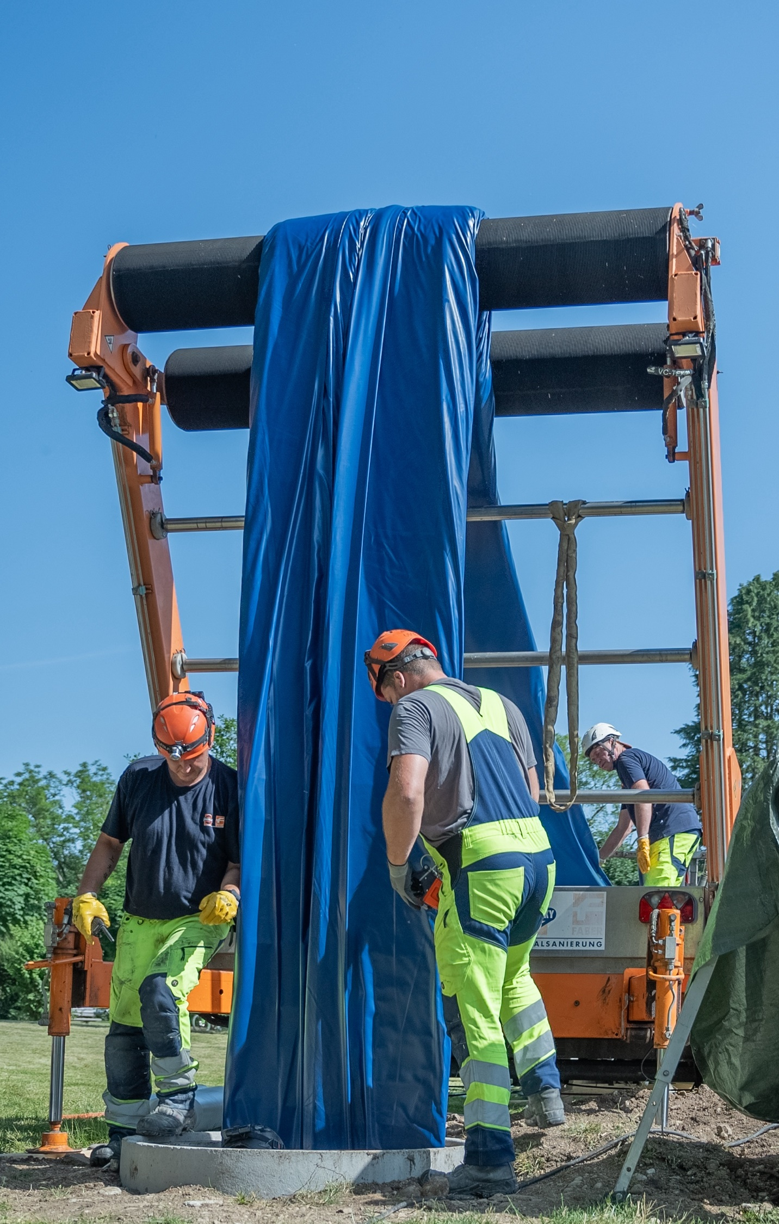
ABOUT US
Performance
Swietelsky Faber general performance
A “no-digging” construction company – active in central Europe for 24 years
> 420 employees
      290 blue collars
      130 engineers, merchants' technicians
Several different renovation-techniques for gravity sewer- and pressure pipes
      GRP-Liner UV- and steam cured
      Epoxy-Liner steam cured
      Close Fit (pre deformed HDPE Pipes)
      Spirally wound pipes
      Discrete-pipes
      Lining with spayed materials
      Lateral liner-installations
      Patch repair
      Manhole rehabilitation
      Coating of tanks …etc.

Slide 8
ABOUT US
Performance
Swietelsky-Faber’s growth in turnover, result and Invest over the years…

Slide 9
ABOUT US
Performance
Swietelsky Faber’s personnel-growth the last years…

Slide 10
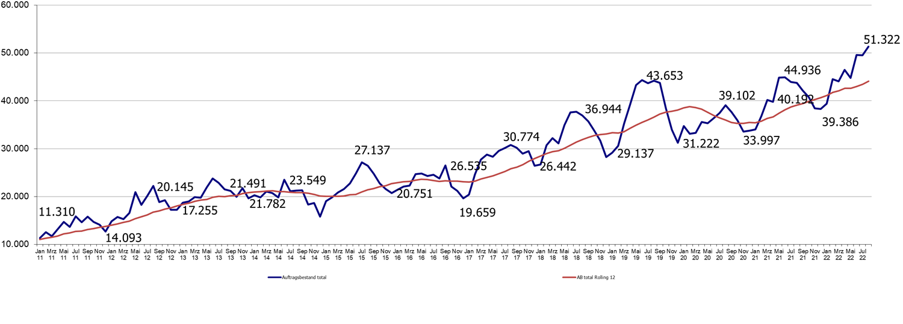
ABOUT US
Performance
Swietelsky Faber’s growth in backlog the last years…

Slide 11
OUR EXPERTISE & SERVICES
"Innovative solutions for tomorrow’s challenges"
swietelsky-faber.com

Slide 12






EXPERTISE & SERVICES
Our Application areas
Sewer
Potable Water
Gas
Oil
District heating
Industry
Process Water
Cooling Water
Firefighting Water
High temperature Water
Power Plant Pipelines
Ventilation Pipes …etc.
swietelsky-faber.com

Slide 13
EXPERTISE & SERVICES
Our Technologies
1
2
3
4
RENOVATION
REPAIR
SPECIAL-Techniques
REPLACEMENT
CIPP
Close-Fit Lining
Discrete-Pipe-Lining
Spirally-Wound-Lining
Lining using coatings
Lateral-Linings
Injection
Spot-Repair using cured in place materials
Metal-Manchettes
Grouting techniques
Top-Hats
Pipe-Bersting
SF-Shaft-Liner
Renovation of big chambers and man-entry-profiles
Renovation of drainage pipes
swietelsky-faber.com

Slide 14
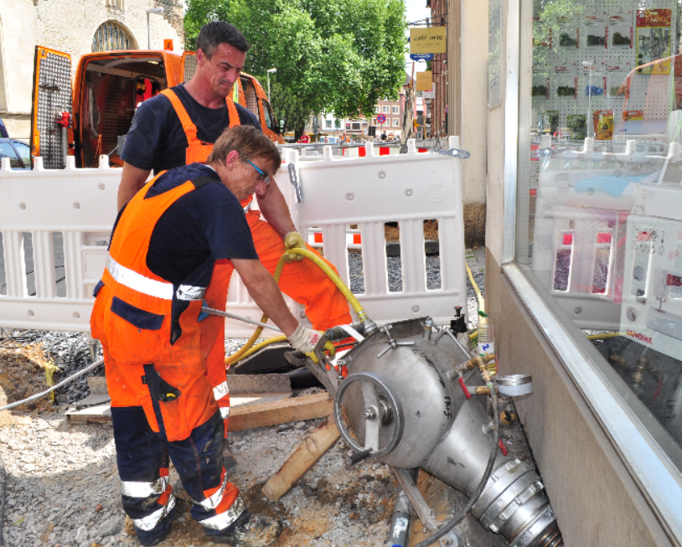
EXPERTISE & SERVICES
Our Services
Renovation of sewers and drains
Renovation of pressure pipes
Berst-Lining…
Lining with discrete-pipes
Repair and renovation of lateral pipes
Tightness tests
Lining for Laterals, Repair and Tightness tests

Slide 15
EXCELLENCE & RECOGNITION
"Building trust through recognition"
swietelsky-faber.com

Slide 16

EXCELLENCE & RECOGNITION
Awards
2015
Winner of the GSTT No Dig Award 2015
For installation of 1000m 1500mm Liner using the UV-curing CIPP technology under very special conditions
2017
Winner of the GSTT No Dig Award 2017
For the development of an own manhole renovation system by using UV-curing CIPP technology
2024
Winner of the ISTT No Dig Award 2024
For installation of 1500mm Liner using the UV-curing CIPP technology under very special conditions

Slide 17
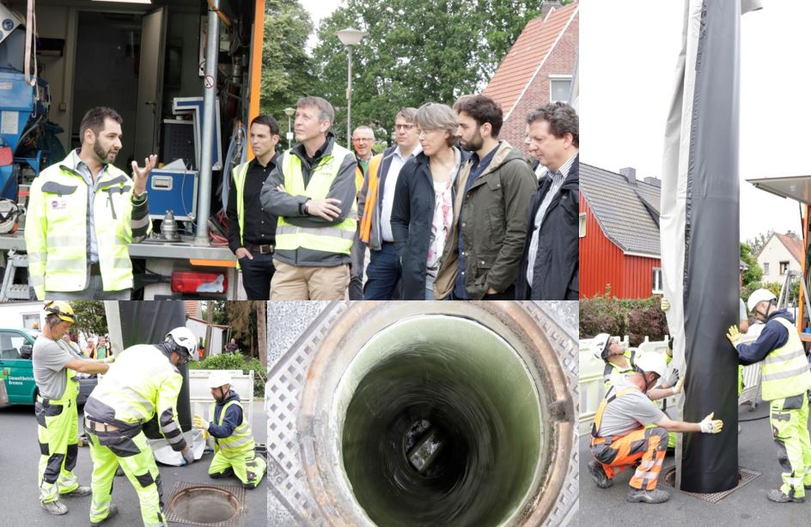
EXCELLENCE & RECOGNITION
Awards
2015
Winner of the GSTT No Dig Award 2015
For installation of 1000m 1500mm Liner using the UV-curing CIPP technology under very special conditions
2017
Winner of the GSTT No Dig Award 2017
For the development of an own manhole renovation system by using UV-curing CIPP technology
2024
Winner of the ISTT No Dig Award 2024
For installation of 1500mm Liner using the UV-curing CIPP technology under very special conditions

Slide 18

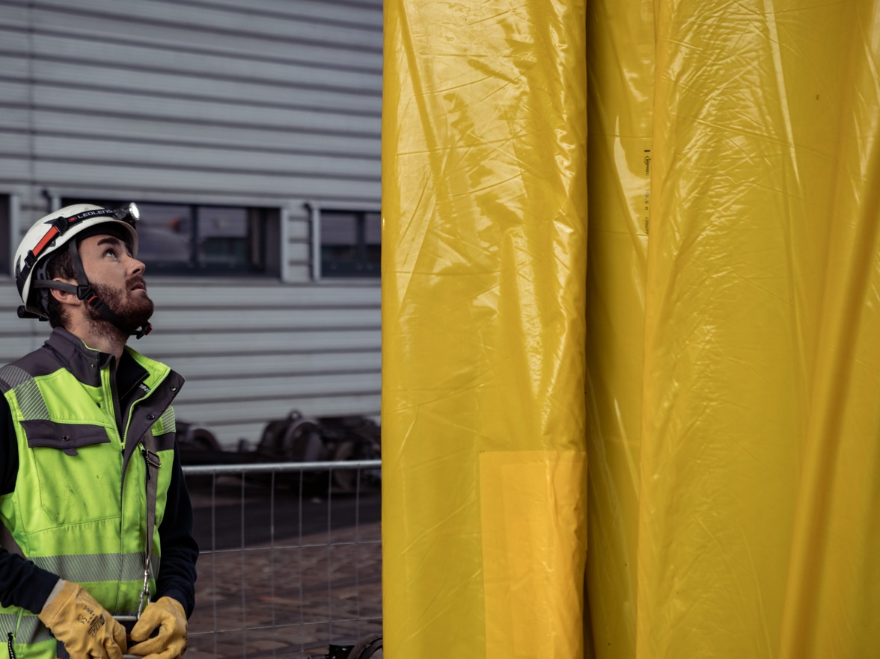
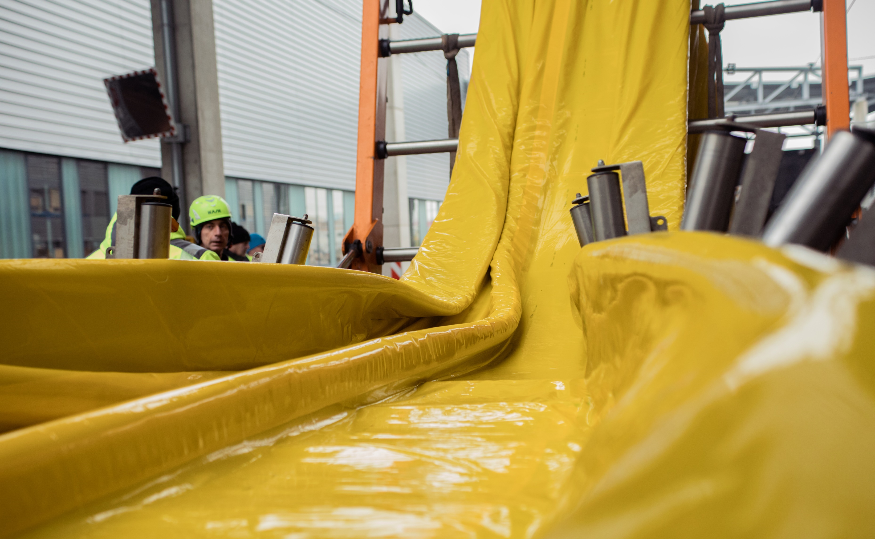
EXCELLENCE & RECOGNITION
Awards
2015
Winner of the GSTT No Dig Award 2015
For installation of 1000m 1500mm Liner using the UV-curing CIPP technology under very special conditions
2017
Winner of the GSTT No Dig Award 2017
For the development of an own manhole renovation system by using UV-curing CIPP technology
2024
Winner of the ISTT No Dig Award 2024
For installation of 1500mm Liner using the UV-curing CIPP technology under very special conditions

Slide 19
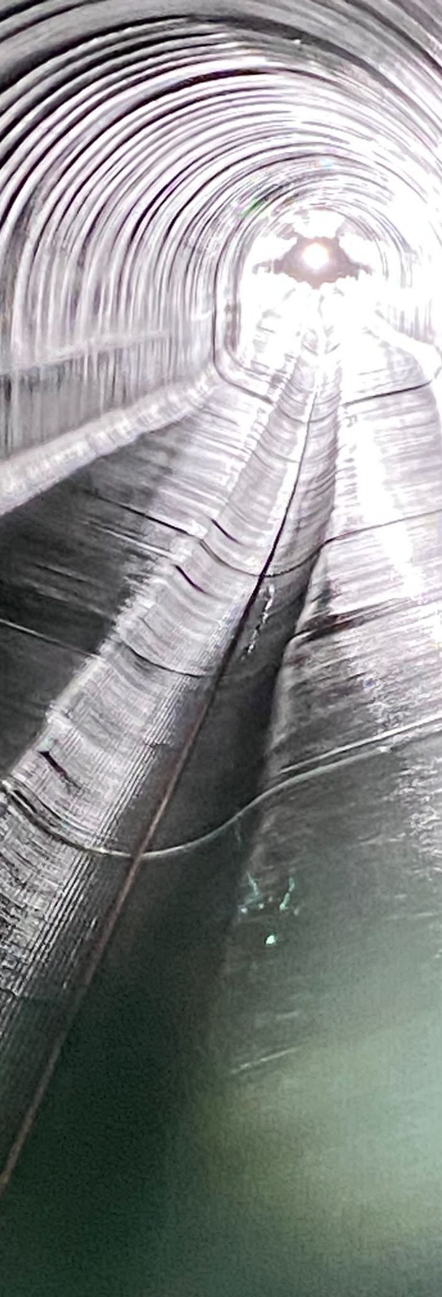
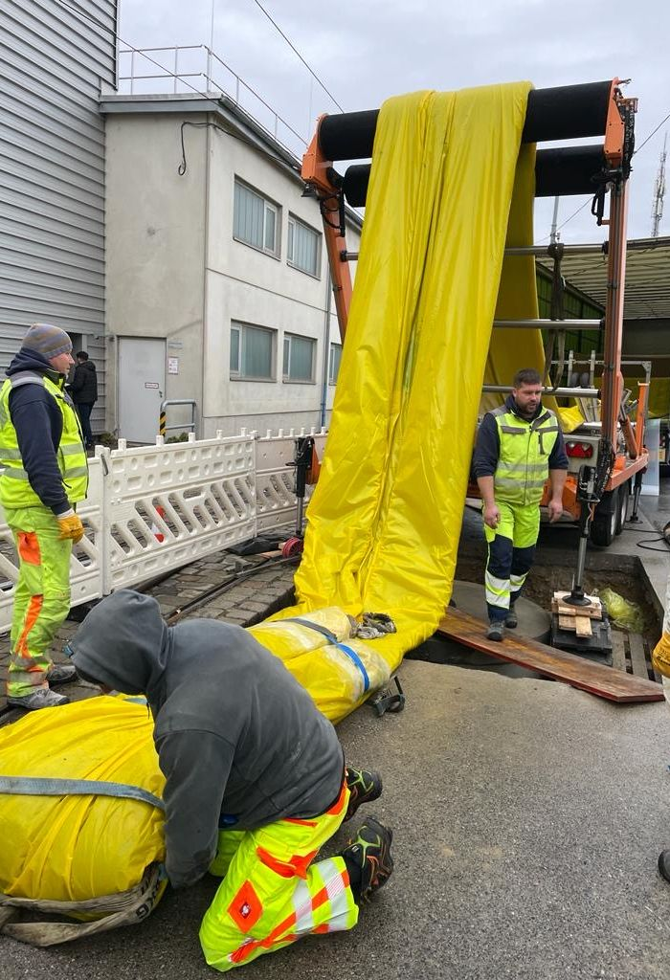
EXCELLENCE & RECOGNITION
ISTT Award 2024
Vienna - UV-Curing CIPP
Bell Profile DN 1500
Final wall thickness: 11,9 mm
Installation 1: 161,90 m – 17,8 tons
Installation 2: 75,10 m – 8,0 tons
Curing speed: 950 mm/min
The major challenge was the weight of the liners!
The renovation was completed in 15 hours by our skilled team.

Slide 20
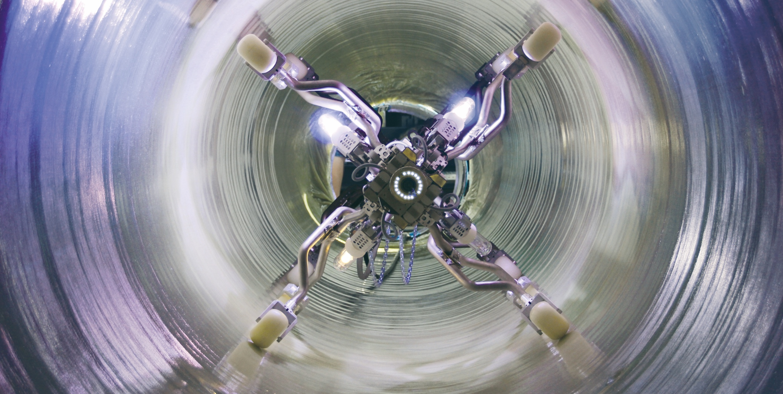
EXTRACT OF CASE STUDIES
swietelsky-faber.com

Slide 21
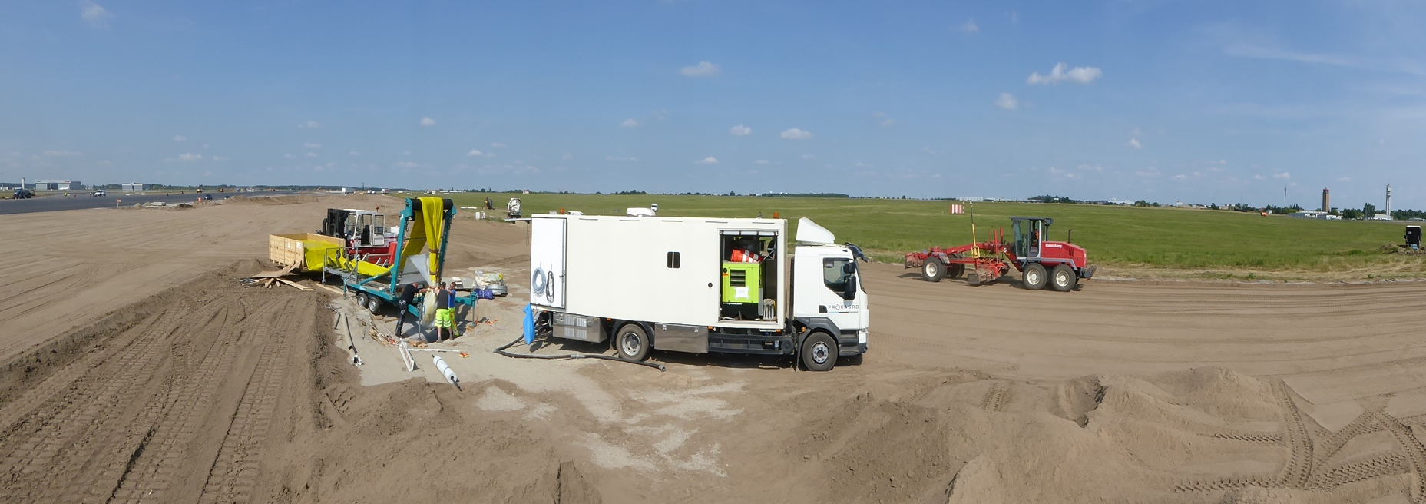
EXTRACT OF CASE STUDIES
Project – Airport Berlin
Airport Berlin 2015
CIPP DN1500

Slide 22
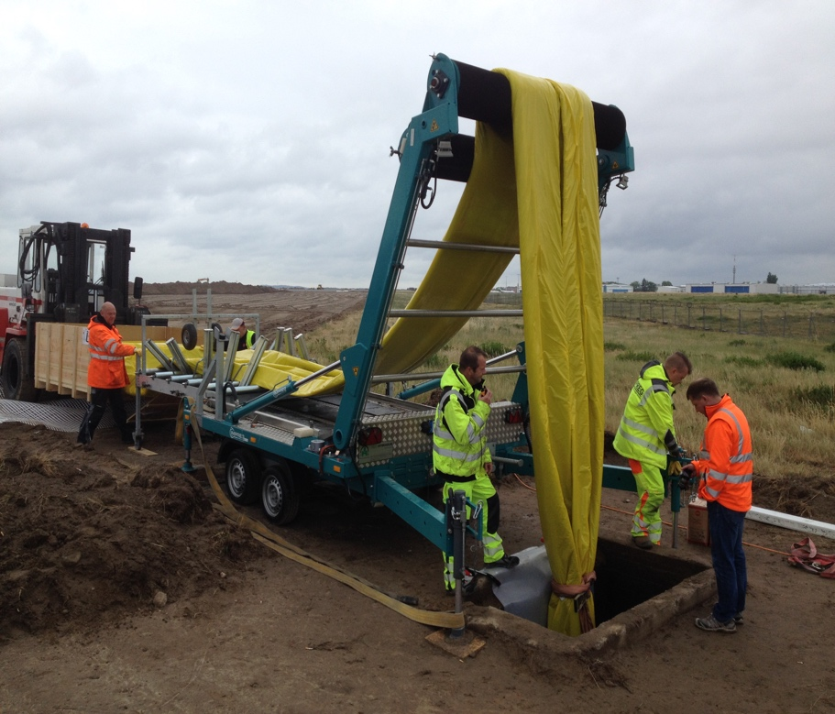
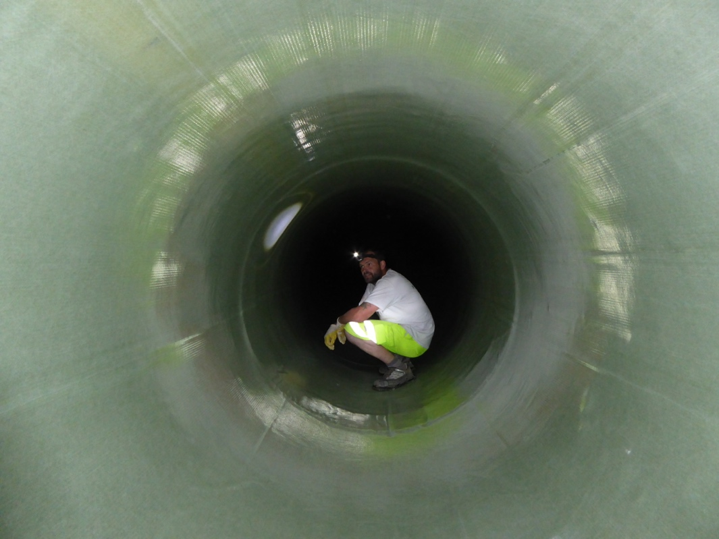
EXTRACT OF CASE STUDIES
Project – Airport Berlin
Airport Berlin 2015
CIPP DN1500

Slide 23
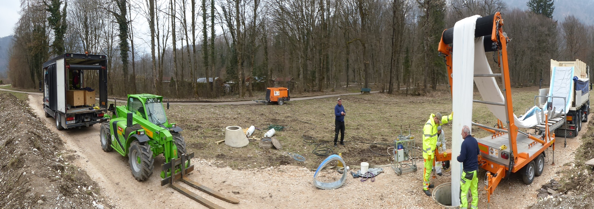
EXTRACT OF CASE STUDIES
Project – Bad Reichenhall
Bad Reichenhall
CIPP Egg-shape DN800/1200

Slide 24
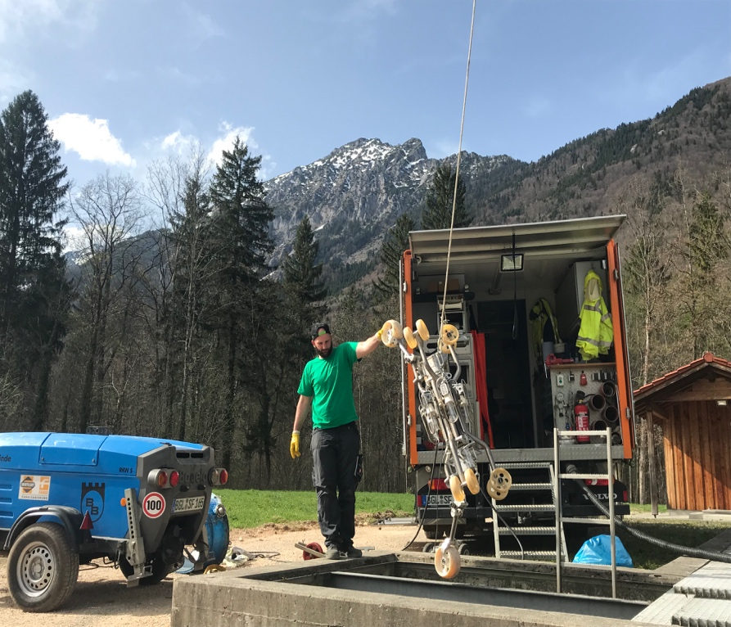
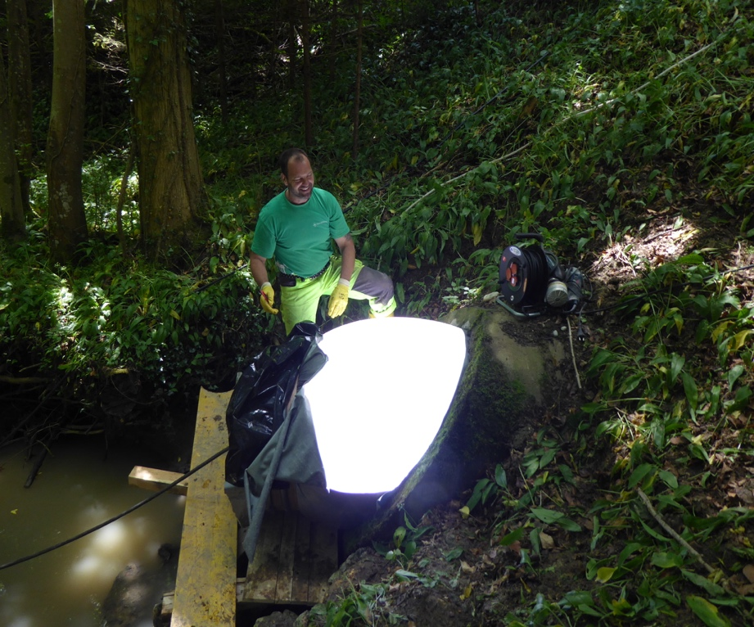
EXTRACT OF CASE STUDIES
Project – Bad Reichenhall
Bad Reichenhall
CIPP Egg-shape DN800/1200

Slide 25
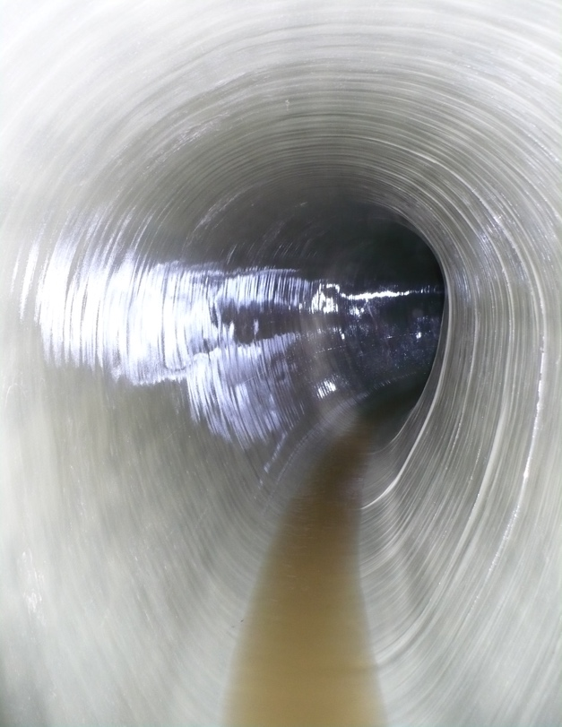
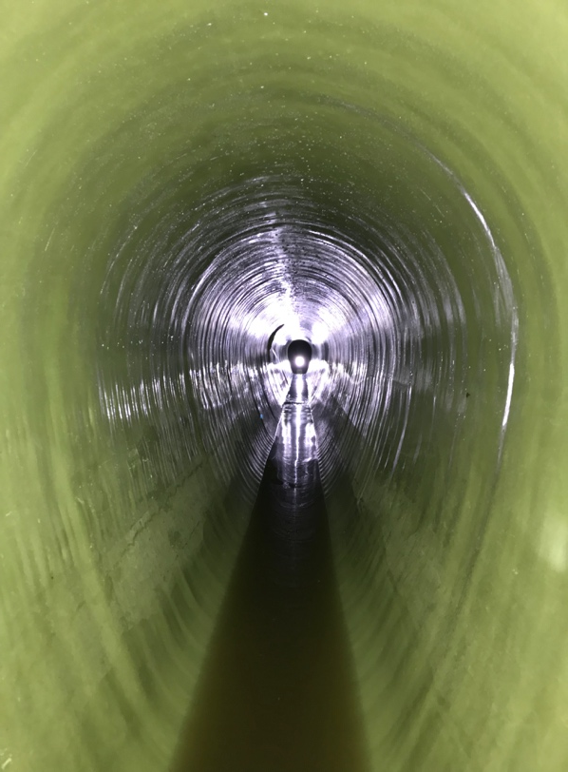
EXTRACT OF CASE STUDIES
Project – Bad Reichenhall
Bad Reichenhall
CIPP Egg-shape DN800/1200

Slide 26
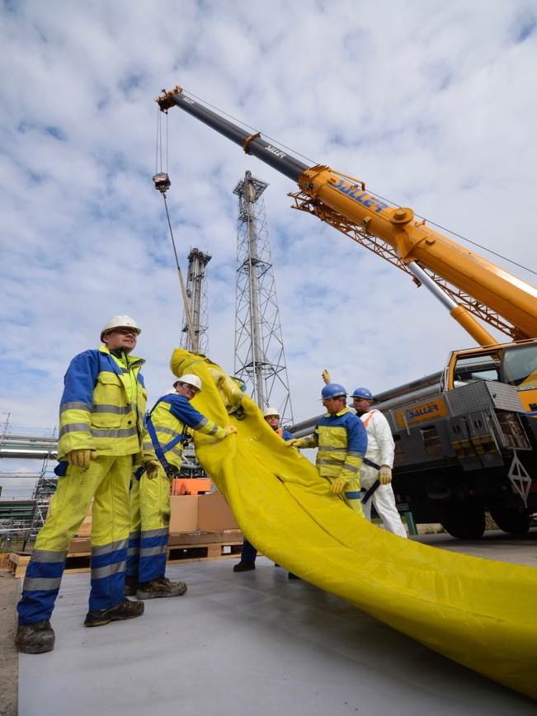
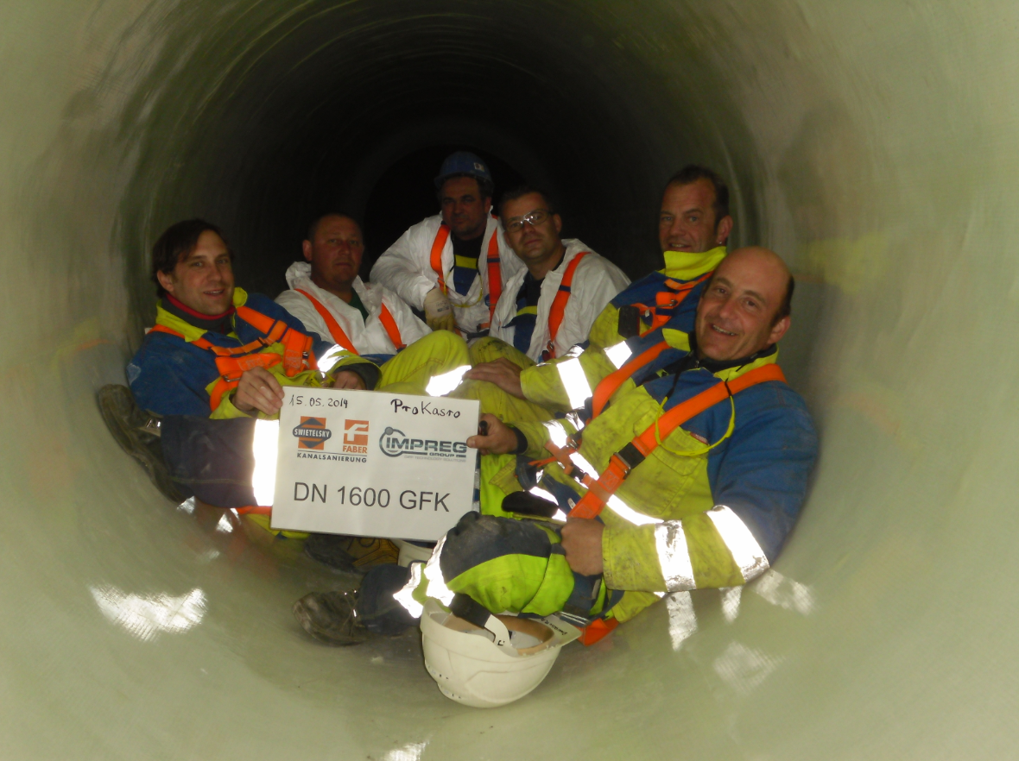
EXTRACT OF CASE STUDIES
Project – Refinery
Refinery OMV Austria
First UV-CIPP DN 1600 worldwide

Slide 27
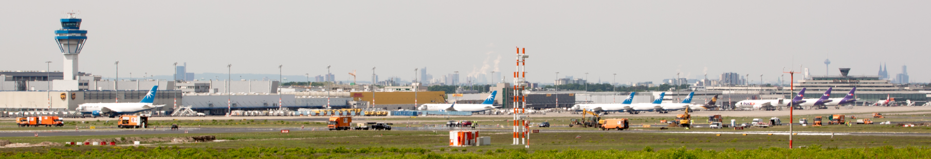
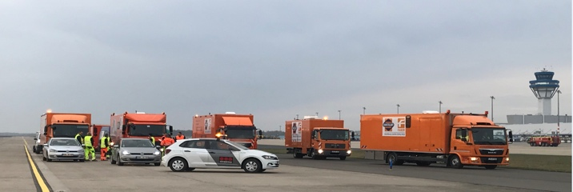
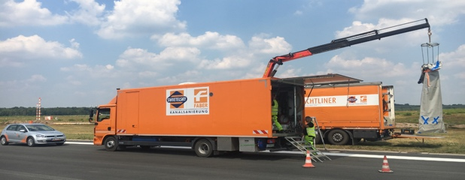
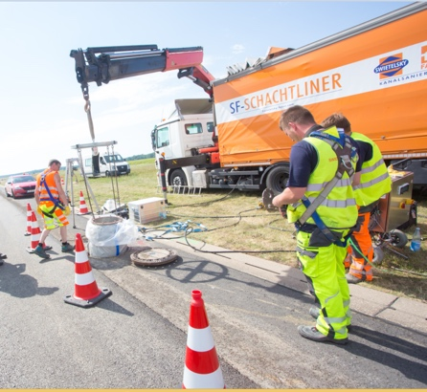
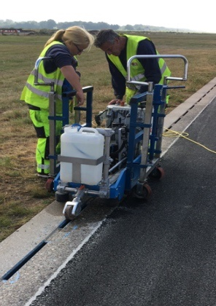
EXTRACT OF CASE STUDIES
Project – Airport Cologne
Airport Cologne
6.000.000 € Order volume

Slide 28
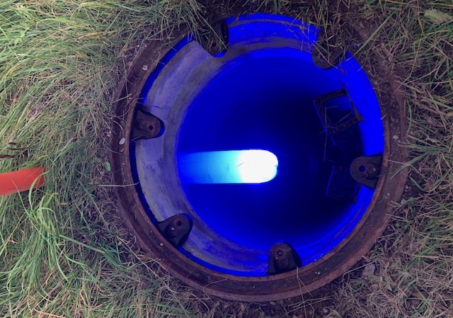
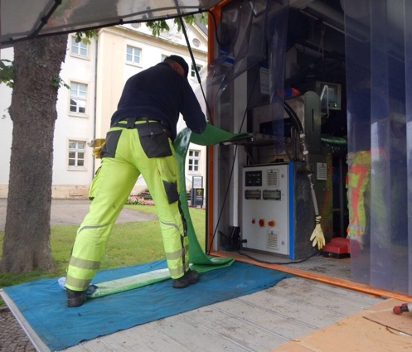
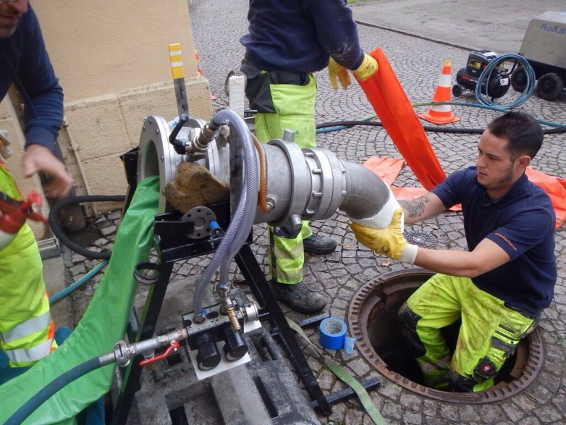
EXTRACT OF CASE STUDIES
Projects – Lateral Connection
CIPP in lateral connections

Slide 29
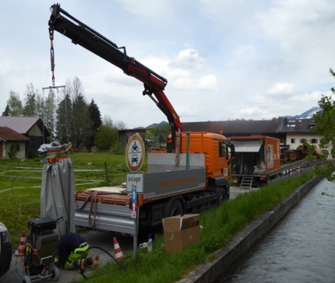
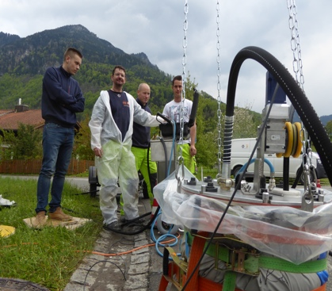
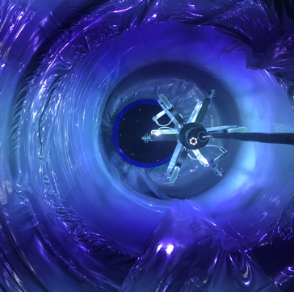
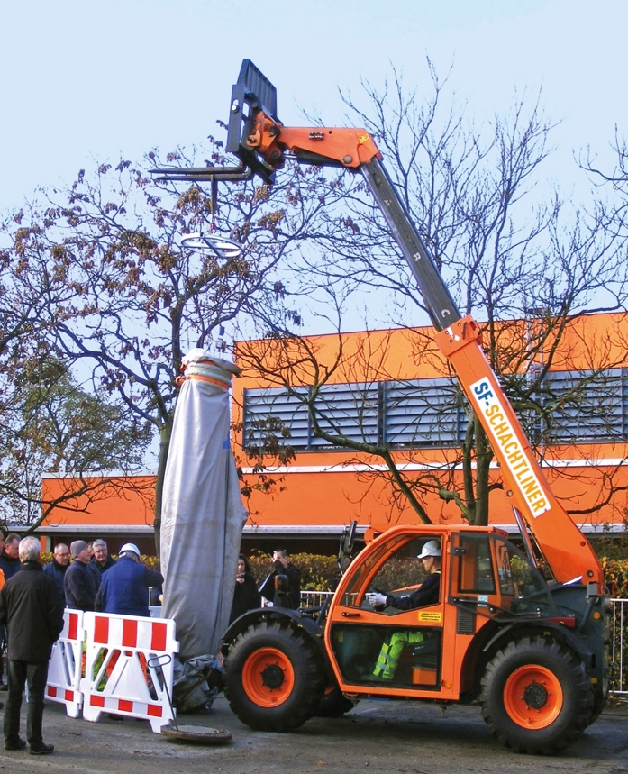
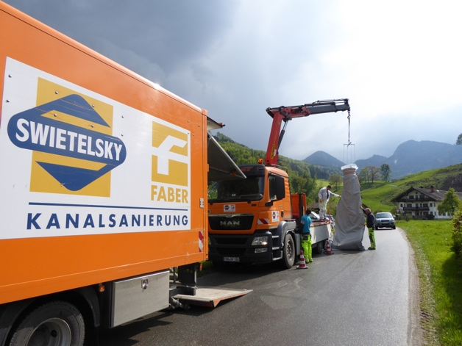
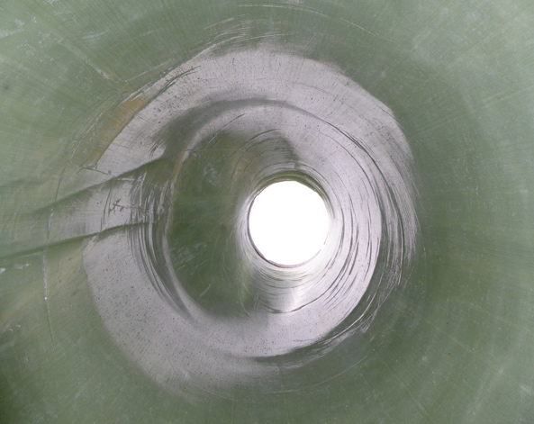
EXTRACT OF CASE STUDIES
Projects – Own Development
UV-Curing CIPP for manholes own development

Slide 30
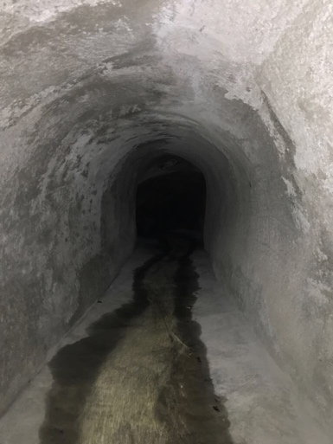
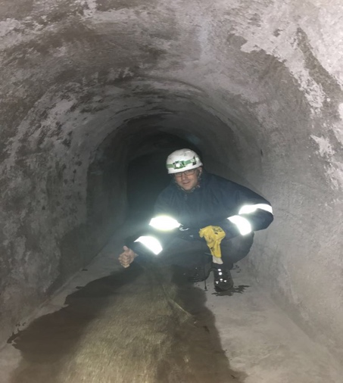
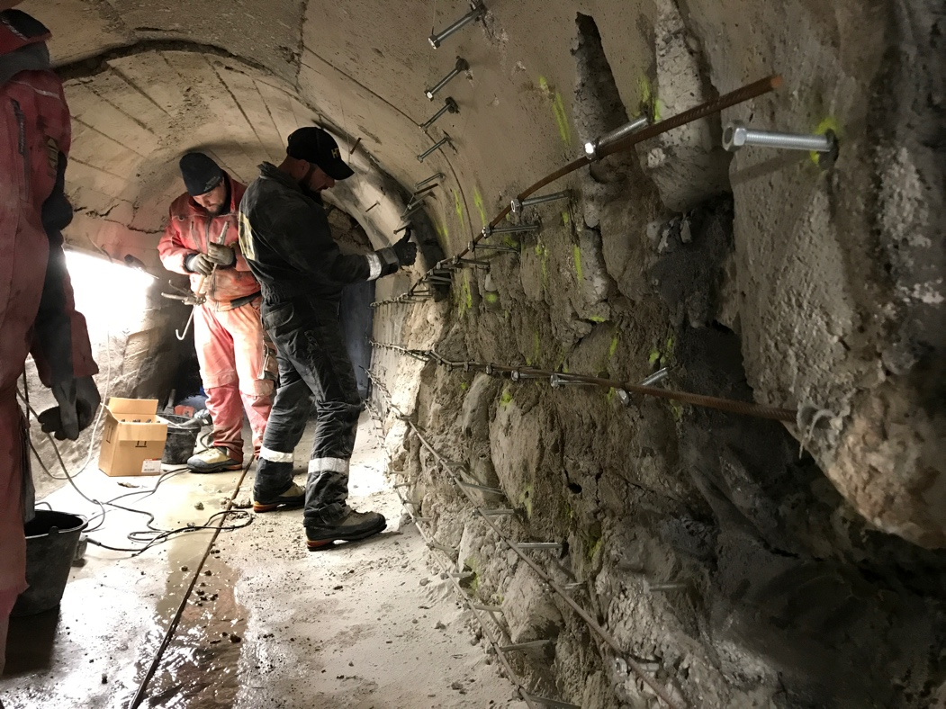
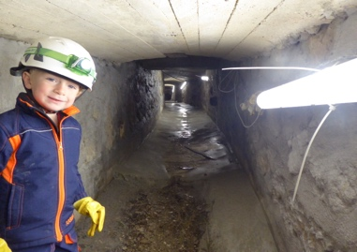
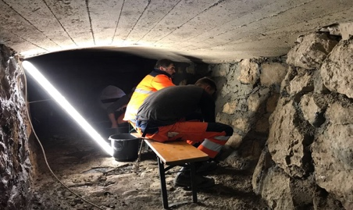
EXTRACT OF CASE STUDIES
Projects – Mortar Coating
Mortar coating and re-construction of big drainages

Slide 31
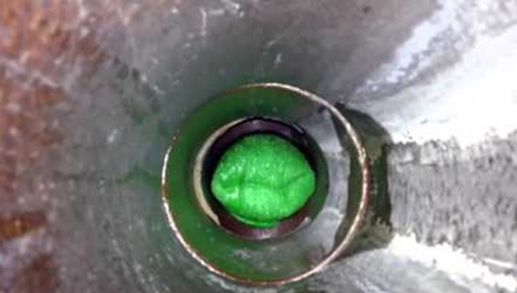
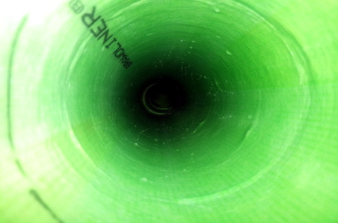
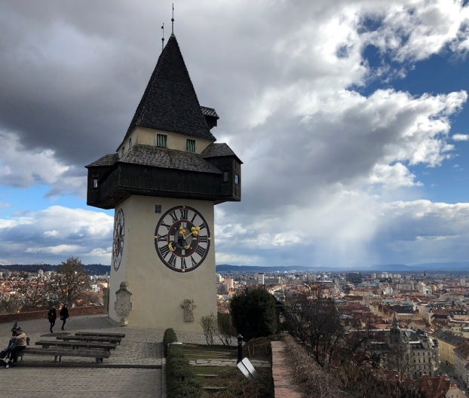
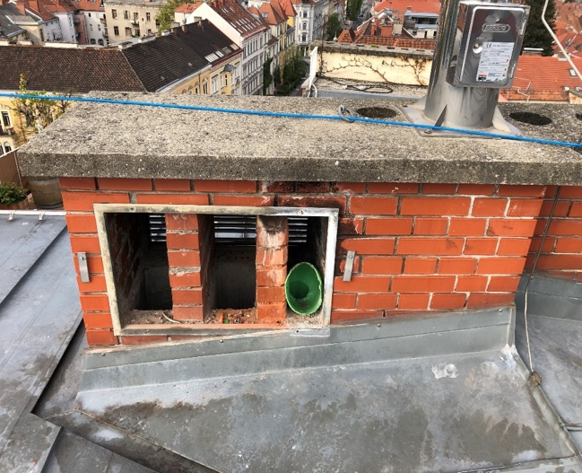
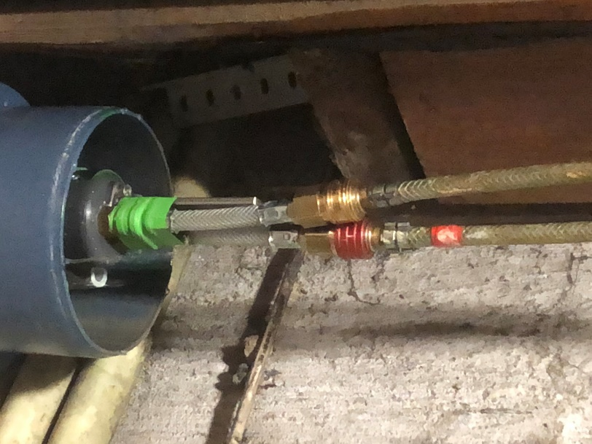
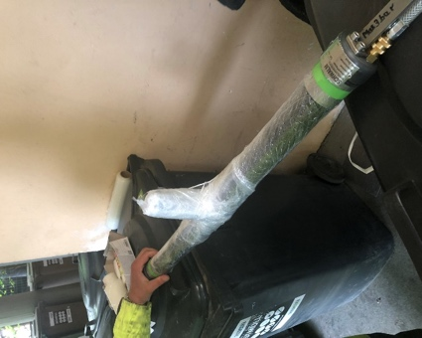
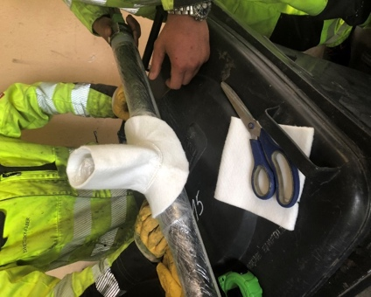

EXTRACT OF CASE STUDIES
Projects – Inside Buildings
Renovation inside buildings

Slide 32





EXTRACT OF CASE STUDIES
Projects – Inside Buildings
Renovation inside buildings

Slide 33







EXTRACT OF CASE STUDIES
Projects – Spiral Wound Technology
Some spirally wound jobs

Slide 34




EXTRACT OF CASE STUDIES
Project - case studies

Slide 35



EXTRACT OF CASE STUDIES
Project – Bodenheim - Close-Fit
Close Fit
Pressure Pipe / Potable Water
DN 250
600 m in two Installations
Only 3 Installation Pits

Slide 36


EXTRACT OF CASE STUDIES
Project – Bodenheim - Close-Fit
Close Fit
Pressure Pipe / Potable Water
DN 250
600 m in two Installations
Only 3 Installation Pits

Slide 37


EXTRACT OF CASE STUDIES
Project – Bodenheim - Close-Fit
Close Fit
Pressure Pipe / Potable Water
DN 250
600 m in two Installations
Only 3 Installation Pits

Slide 38




EXTRACT OF CASE STUDIES
Project – Koblenz
In cooperation with Agriapipe Kft.
ClPP - Pressure Pipe / Potable Water
DN 800
Epoxy Liner – steam curing
Length: 113 m in one shot
Final wall thickness: 13,5 mm
Installation via a T-piece DN 600

Slide 39


EXTRACT OF CASE STUDIES
Project – Weissenbach
In cooperation with Agriapipe Kft.
ClPP – Sewer
DN 600
Epoxy Liner – steam curing
Length: 103,5 m in one shot
Final wall thickness: 12,2 mm
Height difference of 40m

Slide 40

EXTRACT OF CASE STUDIES
Thanks to Agriapipe for the great support!

Slide 41



CONTACT INFORMATION
Yor Contact Swietelsky-Faber
Swietelsky-Faber GmbH
Haidfeldstraße 44
A-4060 Leonding
Gerhard Szigeti
Division Manager
M +43 664 351 03 55
E gerhard.szigeti@swietelsky-faber.at
Christian Hartl
Sales - Industry und Energie
M +43 664 289 7067
E christian.hartl@swietelsky-faber.at
swietelsky-faber.com

