Slide 1

The MAC-System
„Risk assessment of large scale sewers with the MAC-System“
Dr.-Ing. Mark Klameth
Notes:
1
1

Slide 2
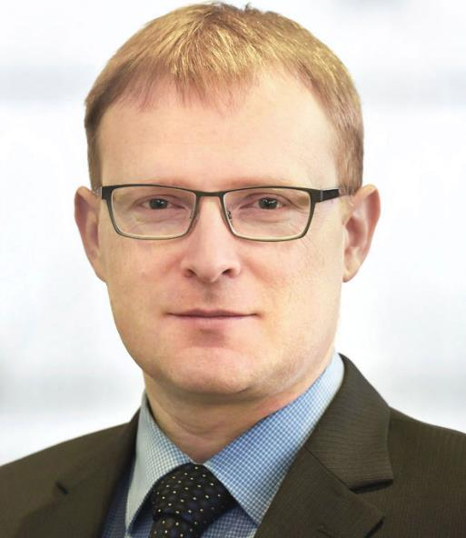
About me
Dr.-Ing. Mark Klameth
Senior Research Assistant at IKT Gelsenkirchen,
Head of Structural Calculations Department
Studies: Civil engineer (University of Hanover)
Doctorate: Institute für Geotechnical Engineering (IGTH)
Topic: Practical Applications of the MAC-Systems
At IKT since 2016:
static calculation of CIPP liners and existing pipe systems
numeric modelling and calculations (2D & 3D)
expertises, damage assessment, material & product testing
seminars, in-house-training, presentations and lectures
Committee member at DWA
Dr.-Ing. Mark Klameth
Email: klameth@ikt.de
Tel.: + 49 209 17806-23
Notes:
Hello from my side. Allow me to briefly introduce myself.
My name is Mark Klameth. I am a civil engineer for geotechnical engineering, working at IKT since 2016.
My area of expertise is static calculations for trench laid pipes and hose liners. I also perform three-dimensional FE calculations, prepare expert reports, give seminars at our company and lectures at universities.

Slide 3







IKT – Structure, Tasks und Partners
IKT – Institute for Underground Infrastructure
2/3 Network Operators
1/3 Economy
> 120 members
> 70 members
Quality Assurance: Construction, Operation, Rehabilitation
Research
Product Tests
QA Testing
Education
Networking
Affiliated Institute / Partner Institute / Teaching
Notes:
What is IKT?
IKT is a neutral, independent, and non-profit institute founded in 1994 with the focus on everything that is related to underground infrastructure. The focus is particularly on sewerage and pipe networks for water, sewage, gas, etc.
The range of services includes:
Research - We investigate factors that influence quality and develop new solutions.
Product and material testing - We compare the basic product quality under realistic operating conditions.
Quality assessment of construction products and systems.
Education – We pass on our collective knowledge to our seminar participants and also give lectures at universities.
Networking: - We offer consulting services, networking and support for municipal network operators, water associations and industry – in other words the public and private infrastructure providers.
Where do you need such an institute?
Whenever and wherever quality, neutrality and independence are important and needed. And this applies to all phases, from construction and operation to renovation. Quality is our main focus that we examine together with the network operators or local authorities.
As we are neutral, we are often accepted by both sides as neutral experts in disputes relating to construction projects.
All of our results can be downloaded from our website free of charge for everybody!

Slide 4
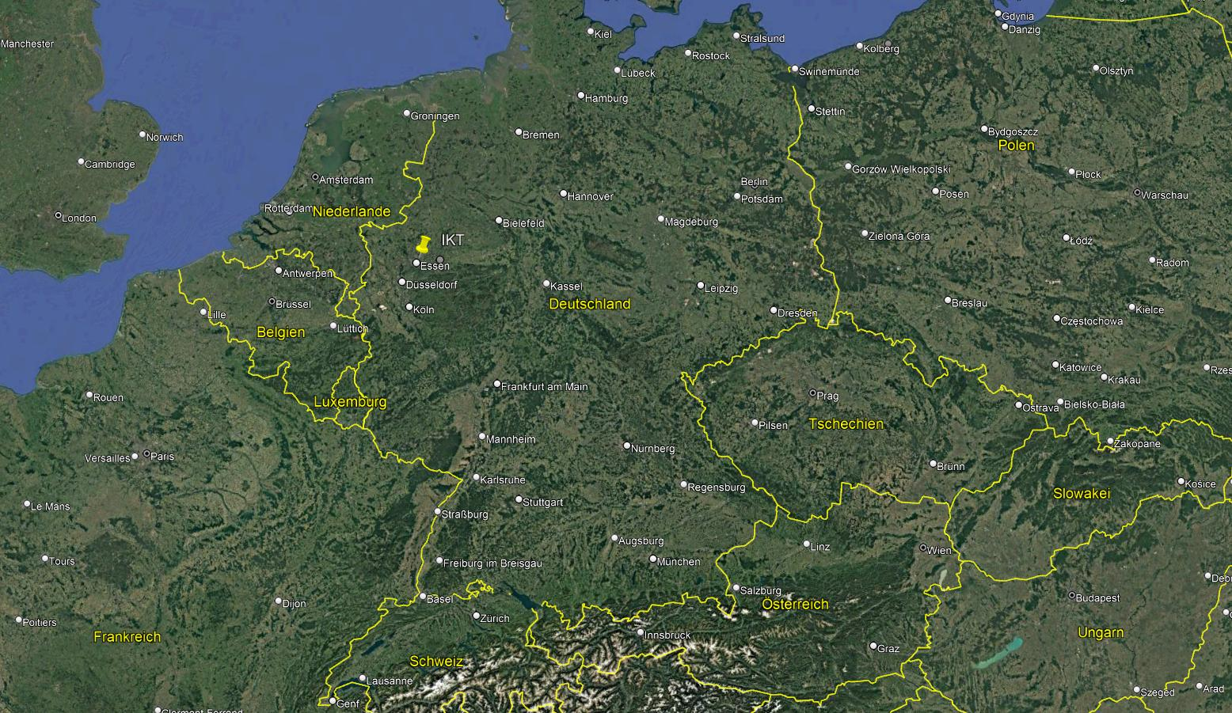
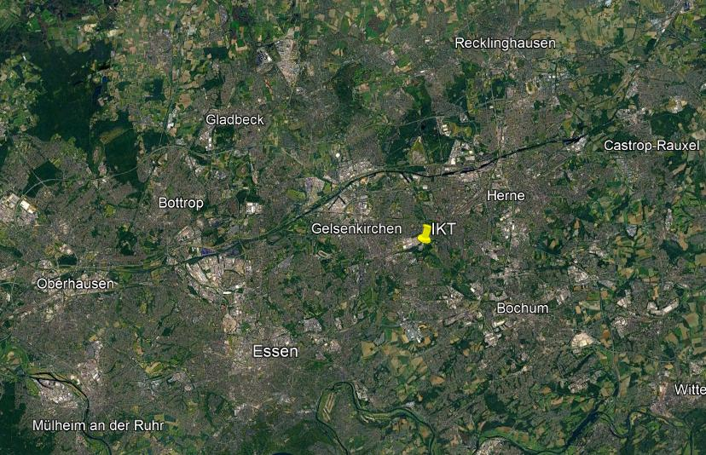
IKT – Institute for Underground Infrastructure
Notes:
Where are we located?
IKT and is based in Gelsenkirchen, in western Germany in the federal state of North Rhine-Westphalia in the heart of the Ruhr area. This is the most densely populated region in Germany with a total population of approximately 5 million people.

Slide 5
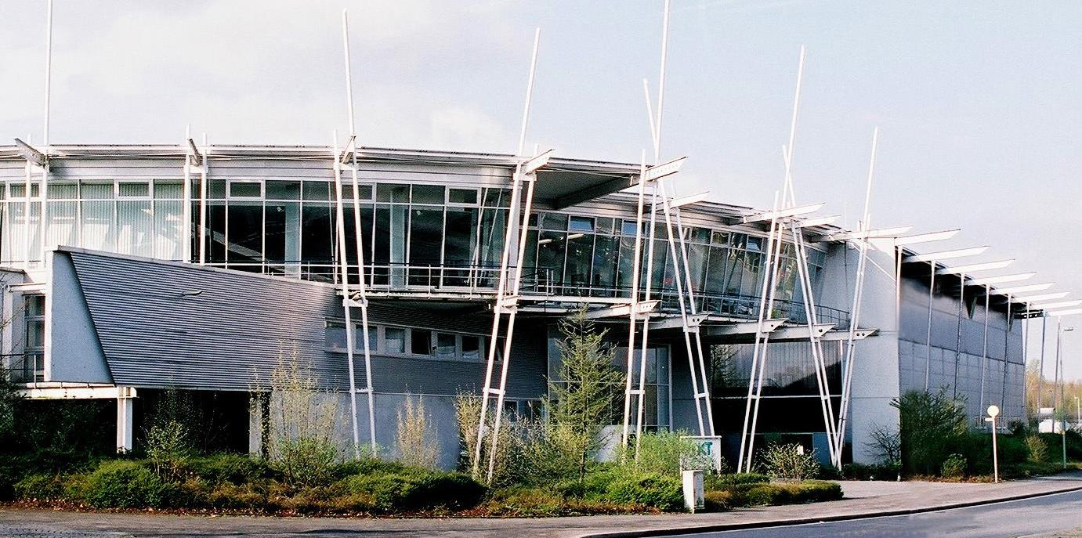
IKT – Institute for Underground Infrastructure
Gelsenkirchen
Offices and seminar rooms
Testing Facilities
Notes:
Here we see our headquarters in Gelsenkirchen. It consists of offices and event rooms in the front part, but also a large testing facility right next door. This is what makes it very special. This way we can conduct research and testing and at the same time our employees, partners and clients can always experience everything up close. Events and discussions can be directly linked to practical impressions from the test facility.

Slide 6
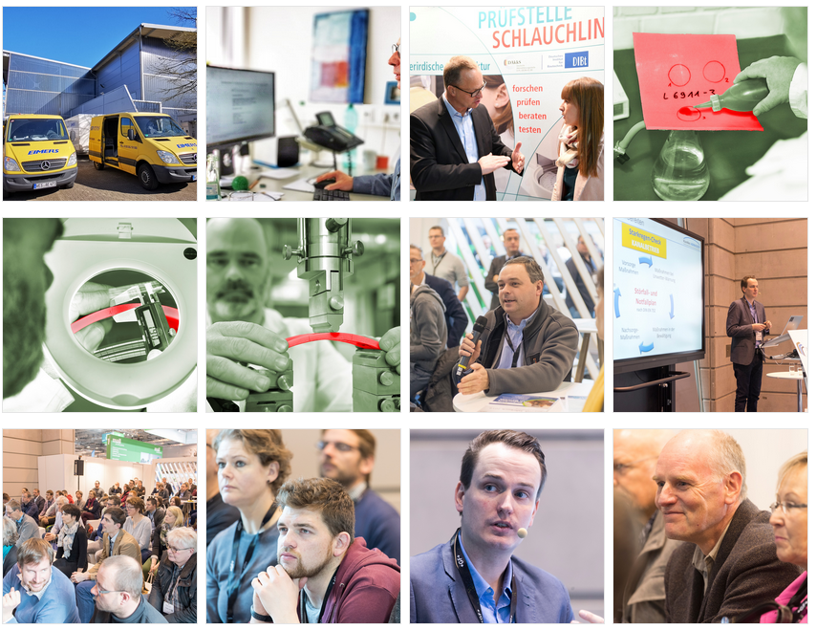
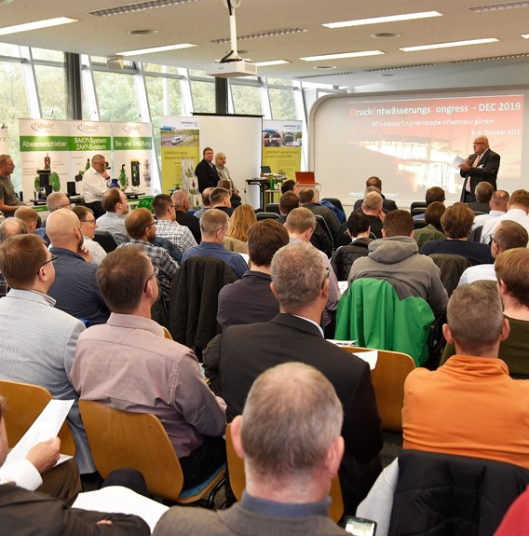
Municipal wastewater network
… a strong community of wastewater companies that support each other in terms of technology, organisation and operations.
Notes:
In our wastewater network, we support our participants and help them with questions about problems that arise in their everyday work. We hold video conferences and discuss issues that affect everyone. It often turns out that other companies have the same problems. Some have already found solutions, which are then shared. So we bring people together and work in the background as a ‘think tank’ for the municipal wastewater network.

Slide 7
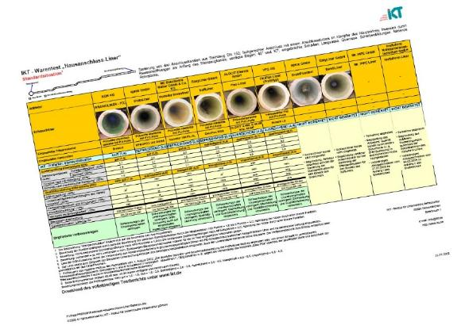

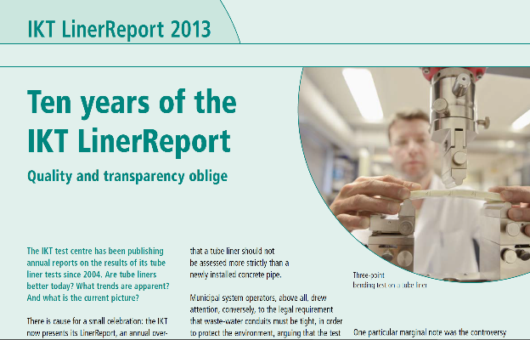
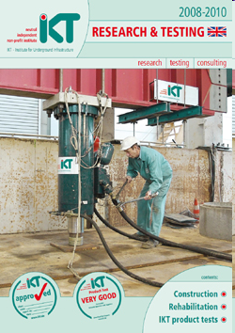
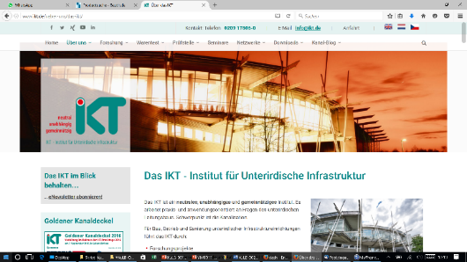
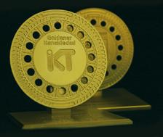
Reports for download at www.ikt.de or www.ikt-online.org
Downloads
Notes:
And since we are oriented towards the common good, many of our findings are also available for free download on the Internet.
Typical examples are our product tests, our quality reports and, of course, all our research findings. We always endeavour to obtain permission from our clients to publish the findings, and the federal, state and local authorities in particular are very open in this regard and are happy to do so.

Slide 8
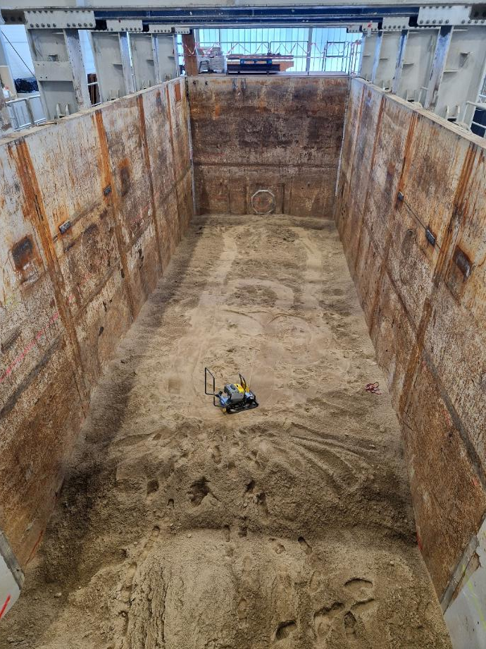
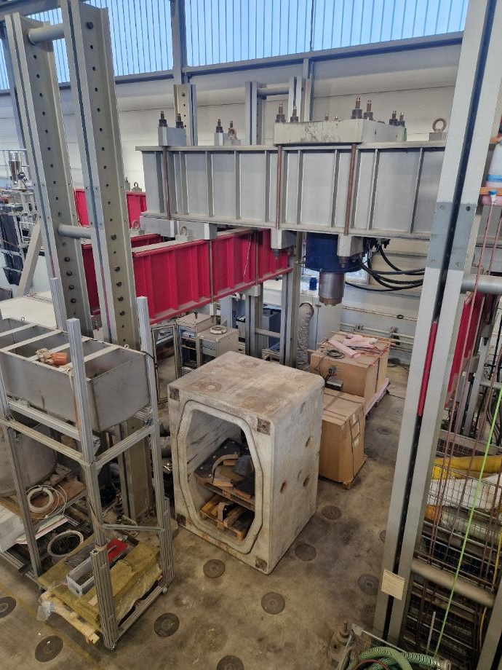
IKT – Facilities
Notes:
On this slide you see an impression of our testing facilities. The following pictures show parts of our testing facility in Gelsenkirchen.
On the left-hand side, we see our ‘sandpit’ (18 m x 6 m x 6 m), where we can test everything on a scale of 1:1. The sandpit can also be filled with water to simulate ground water influence or uplift effects.
Here we have tested our recent projects e.g. pressure liners and flowable backfill
On the right-hand side, we see our portal press with a force of up to 4,000 kN for crown pressure testing of large scale profiles and uniaxial compression testing.

Slide 9
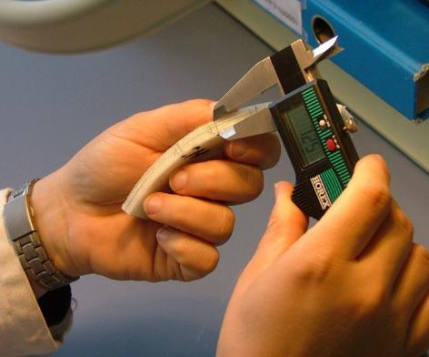
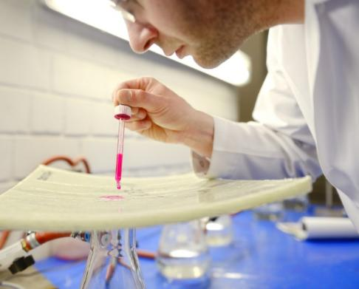
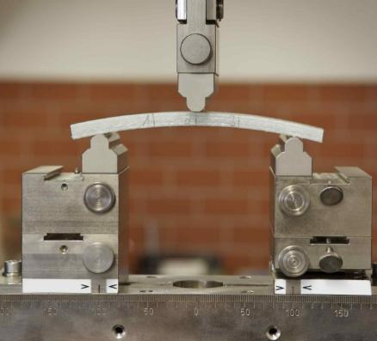
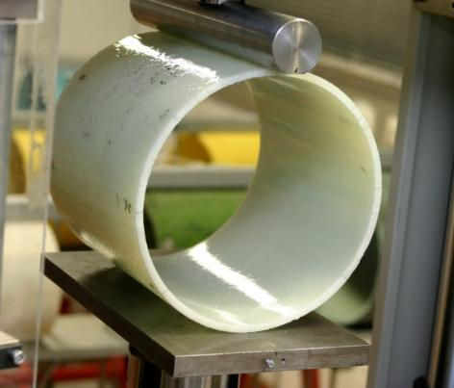
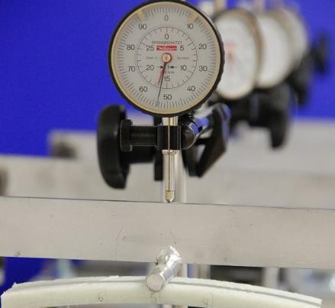
IKT – Laboratory for CIPP Liners
Composite thickness
Watertightness
3-point bending test
Optical inspection
Crown pressure test
Long-term properties
Notes:
We also have our own testing laboratory for testing samples from pipes and CIPP liners for their material properties. What you can see here is just a small selection from our range of services.
Since 2024 we also have a second laboratory with even more advanced testing equipment.

