Slide 1
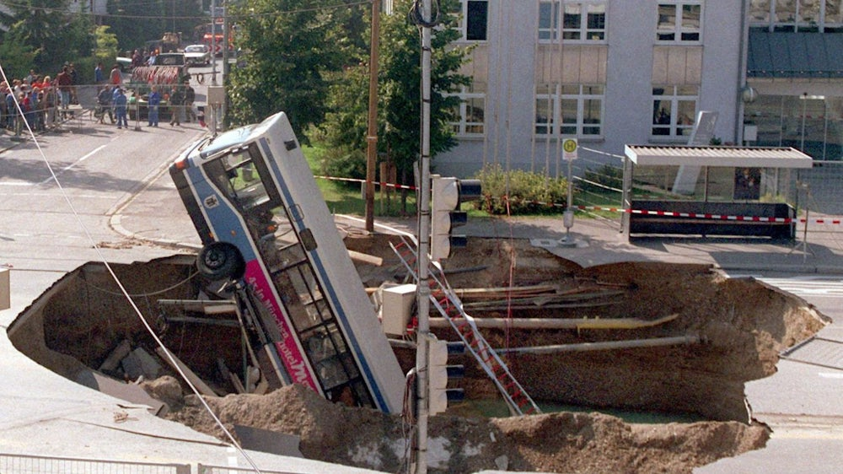
Risk assessment on large scale sewers
What does Risk mean?
Risk = Probability x Effect
„Crater of Death“ in Munich/Trudering, 20.09.1994, Collapse during Metro construction
Result: 3 dead, >30 injured
Chance that
it happens?
Consequence
if it happens?
Condition of the sewer
Dimension of the sewer
Foto: picture-alliance / dpa
Notes:
Before we start with the presentation: What am I actually talking about today? What does risk mean with special regard to large scale sewers? Risk = Probability x Effect. Where Probability means the chance of something happens to our sewer. This depende mainly on ist condition and the structural load on it. While Effect describes the consequence of potential failure. The Risk increases basically with increasing diameter.
Example shown on the right side: Collapse of Metro construction in Munich in 1994 with fatally injured passengers.

Slide 2


What is the MAC-System?
  MAC = Mechanical Assessment of Conduits
  Non-destructive testing method for the
  determination of both the condition and
  structural integrity of accessible sewers
  Developed by Olivier Thépot (Eau de Paris),
  Application in France since 1989,
  > 40 km testing of sewers per year
  Cooperation between Eau de Paris and IKT
  Add-on to the regular optical inspection
Optical
inspection
good .
MAC-Test
bad .
Notes:
(Reading bullet points)
Optical inspection: good / bad ?
MAC-Test: good / bad ?
Permutations: g/g = OK!, b/b = revovation, b/g = saving money, g/b = happy to have the MAC!

Slide 3
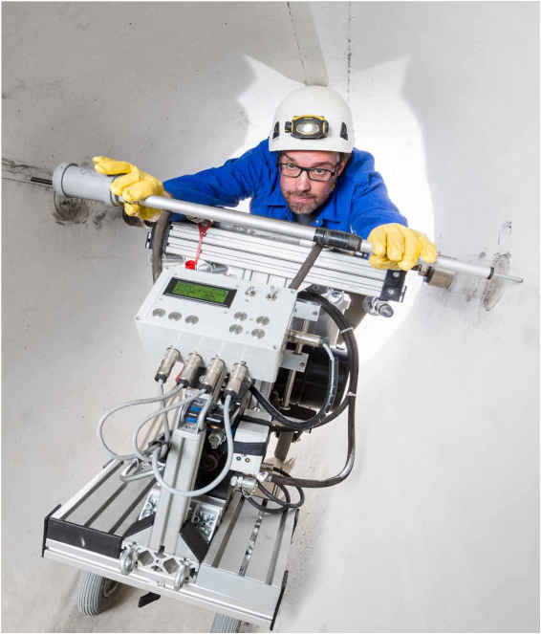
Operating Principle
u₀
F
u₁
u₂
F
D
u₀
d₁
MAC-Stiffness :
Transmission ratio:
Applicable in various profiles (circular, egg-shaped etc.)
from DN 1000 up to > DN 2000
Materials: Concrete, brickwork, synthetic etc.
Non-destructive testing: F_{max} < 100 kN, u_{max} < 300 µm
Notes:
The MAC system essentially consists of a hydraulic press that applies force to the sides of the sewer wall. The resulting deformation is measured using displacement transducers. Force and displacement are limited so that everything remains within the elastic range and no damage is caused to the sewer. Two variables are measured: The MAC-Stiffness and the transmission ratio along the sewer.
In principle, the method can be used in all sewer shapes and with all materials from DN 1000 upwards.

Slide 4
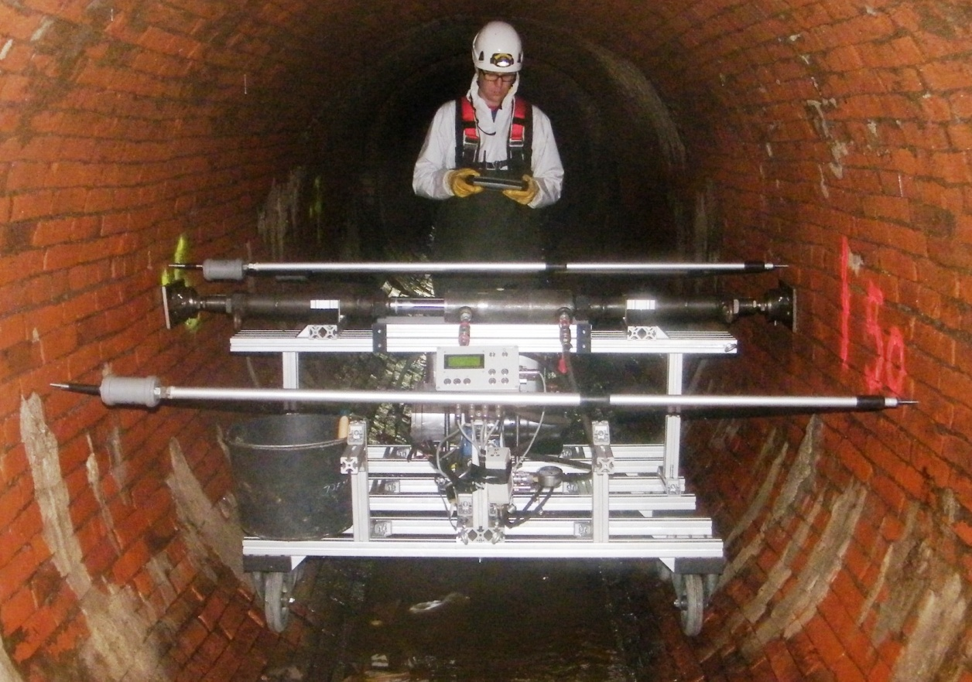
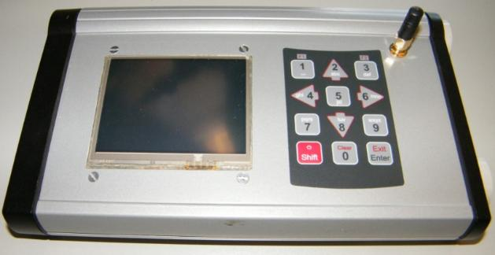
Application in Sewer
Notes:
Here we see the MAC in use in a DN 2000 masonry sewer in Hamburg. The chassis was adapted to the dimensions of the sewer. It is controlled via a wireless remote control.Two workers are needed to push the device to the individual measuring positions.

Slide 5
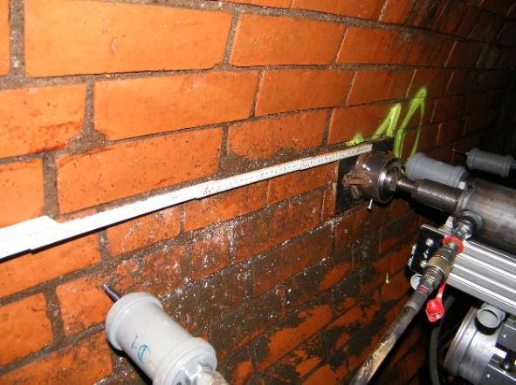
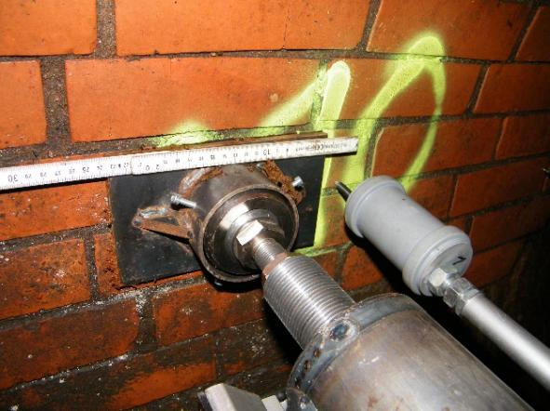
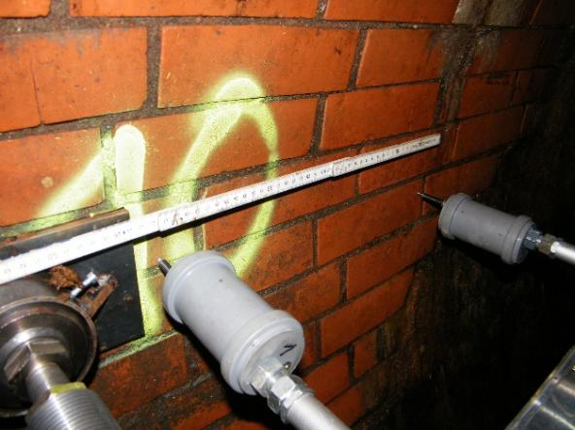
Application in Sewer
Spacings and Measurements
Spacing between the measurement points: 5 to 10 m
Positioning of hydraulic press and transducers: 50 to 100 cm
Three testing cycles (fixing, measuring, checking)
Notes:
Usually, measuring points are approached every 5 to 10 metres, depending on requirements and the condition of the sewer. The hydraulic press is then moved into position and three measurements are taken. The first measurement is used to fix the device in place, the second is the actual measurement and the third is used for verification. The next measuring point is then approached.

Slide 6
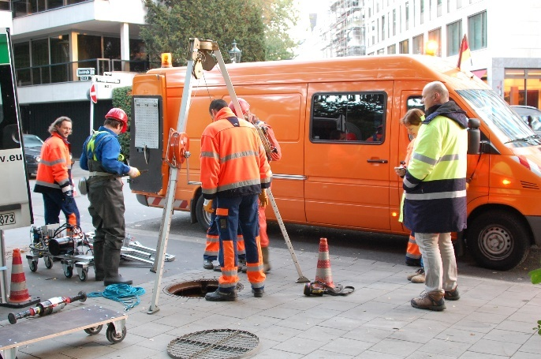
Planning and Preparation
Planning
Review of plans and reports
Preliminary FE-calculation
Securing of entry site
Optical pre-inspection
Ventilation of sewer
Securing of exit site
Notes:
Reading bullet points.

Slide 7
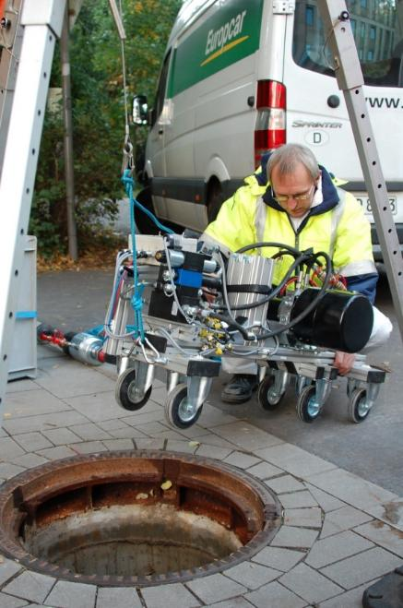
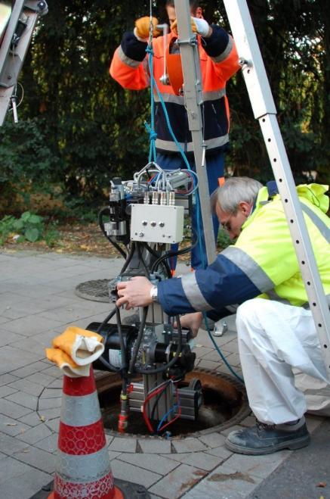
Time Frame
Example
One-day test
Egg profile DN 950/1400
Length: 150 /250 m
Measuring points: 15 /25
Depending on the sewer condition
1h
1h
4-5h
3/4h
Preparation
Installation
Measuring
Removal
Evaluation
Notes:
A typical test day looks like this: You arrive on site and prepare the device. In the meantime, you inspect the sewer to identify any obstacles and determine the measuring points.After installing the device in the sewer, the test is carried out and the device is then removed again.The evaluation is then carried out in the office.

Slide 8
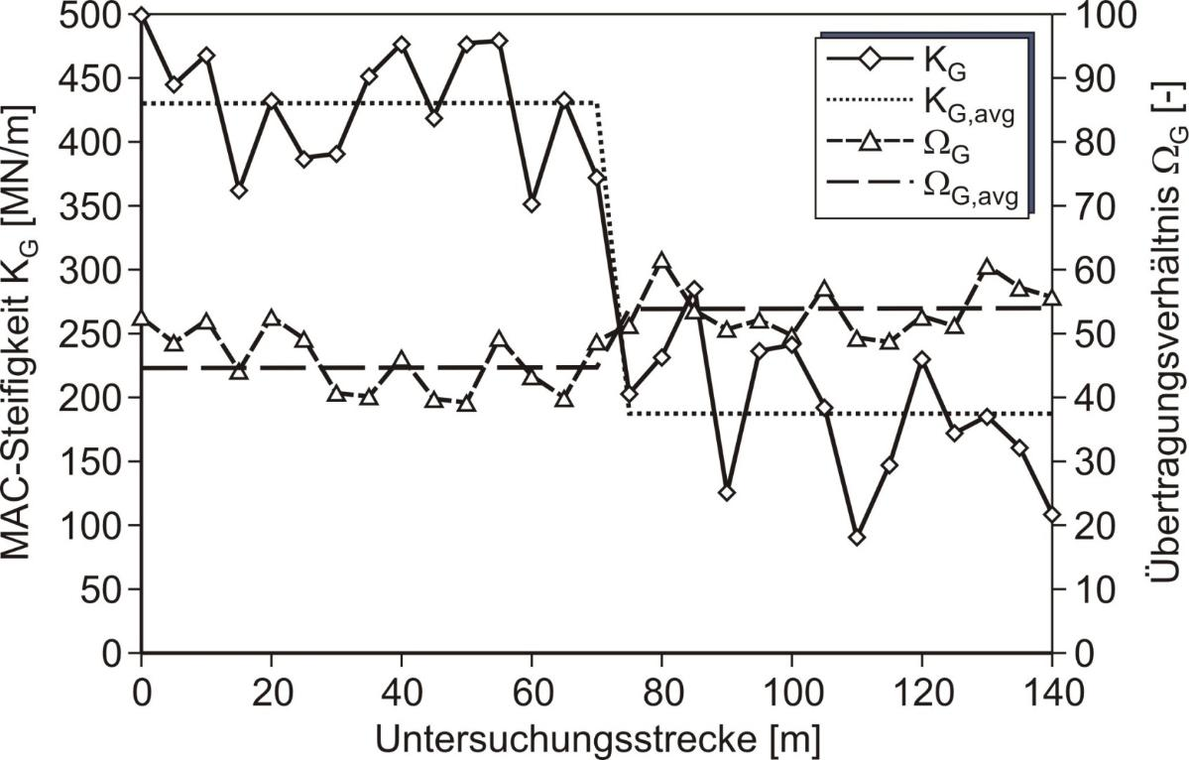
Assessing the MAC-Data 1
System variables
- MAC-Stiffness K_{G}
- Transmission ratio Ω_{G}
MAC-Stiffness K_{G} [MN/m]
Transmission Ratio Ω_{G} [%]
Zone 1
Zone 2
Examination length [MN/m]
Notes:
With the help of the evaluation, the investigation section can then be divided into individual homogeneous areas with similar properties. In addition, points can be determined that appear particularly weak and where the extraction of drill cores could be useful.

Slide 9
Assessing the MAC-Data 2
Condition of the Sewer
Quality Index QI [%]
E-Modulus in relation to
calc. new condition
Quality Index QI [%]
Examination length [MN/m]
Notes:
With the help of computer-assisted comparative calculations, a quality index can then be generated from the results. This indicates how good the stiffness of the sewer is in comparison to its calculated new condition.
The exact specification is determined on the basis of the static boundary conditions of the sewer.

Slide 10
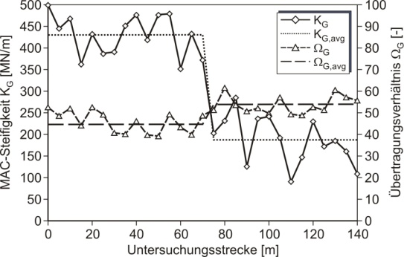

Results of the MAC-Tests 1/3
Results of the MAC-Testing
Classification into homegenious sections
Uniformity of the pipe-soil system
Detection of weak spots
Determination of extraction points for core samples
Determination of Structural Capacity
Separation of pipe and soil by numeric calculation
Determination of E-Modulus of pipe and soil
Static calculations according to
ATV-A 127 (trench laid pipes) or DWA A 143-2 (CIPP-Liners)
Notes:
What you get directly from the MAC test are the homogeneous areas of the channel, the structural weak points in the system and the locations where core sampling might be useful.
Furthermore, the modulus of elasticity of the sewerwall and the soil behind it can be derived from a numerical comparison calculation. These then serve as input values for static recalculations of the sewer.

Slide 11
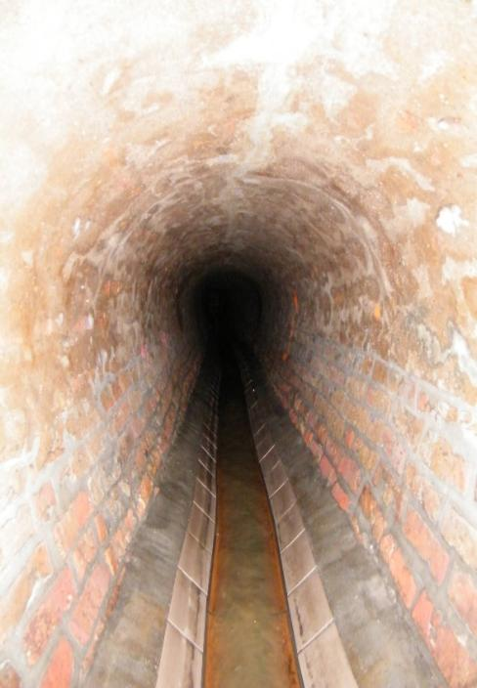
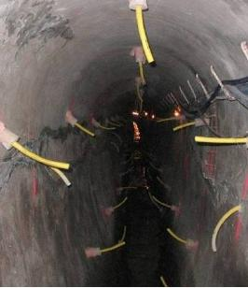
Results of the MAC-Tests 2/3
Definition
Host pipe condition I / II
Determination of zones
Renovation
Selection of method and material
Preservation / sealing /
hydraulics / soil improvement
Performing of rehabilitation
Notes:
With regard to the renovation of the sewer, you can first determine the condition of the sewer and divide it into homogeneous areas.This usually allows you to determine the required renovation method. This generally depends on the target size: for example, do you only want to seal the sewer, improve its hydraulics or reinforce its structure?

Slide 12
Results of the MAC-Tests 3/3
Quality Assurance
Second MAC-Test
Performing before-after comparison
Proof of long-term Effect
MAC-Tests in defined intervals
Trend over time
© Eau des Paris
Notes:
As a quality control measure, you can carry out a before-and-after check to see whether the action was successful.
You can also carry out recurring inspections to detect potential deterioration in the condition of the sewer at an early stage and take timely action.

Slide 13
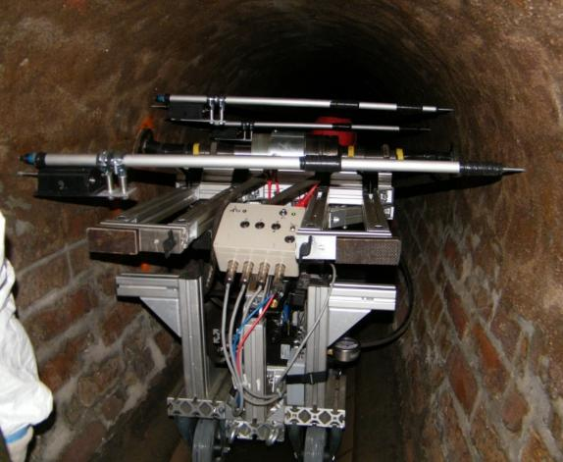
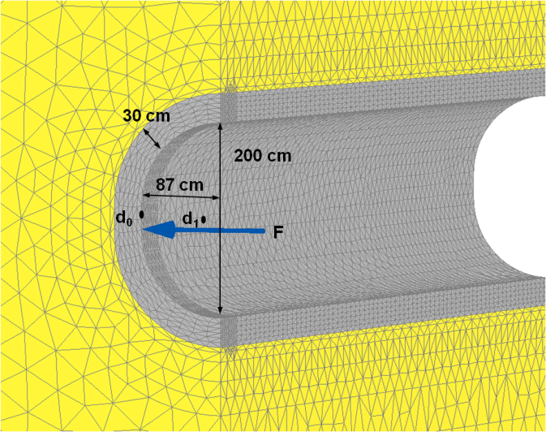
Complete Package 1/2
MAC-Test:
Determination of system
variables: K_{G} und Ω_{G}
2. FE calculation:
Conversion of system variables in elastic modulus of pipe and soil
3. Statics:
Structural safety
Notes:
The complete package therefore consists of the MAC test itself, the numerical calculation for comparison and the subsequent static recalculation of the sewer.
In principle, the numerical calculations can also be performed beforehand. This provides a plausibility range for the results from the MAC test and allows you to see directly during the measurement whether the values obtained are reasonable or not.

Slide 14
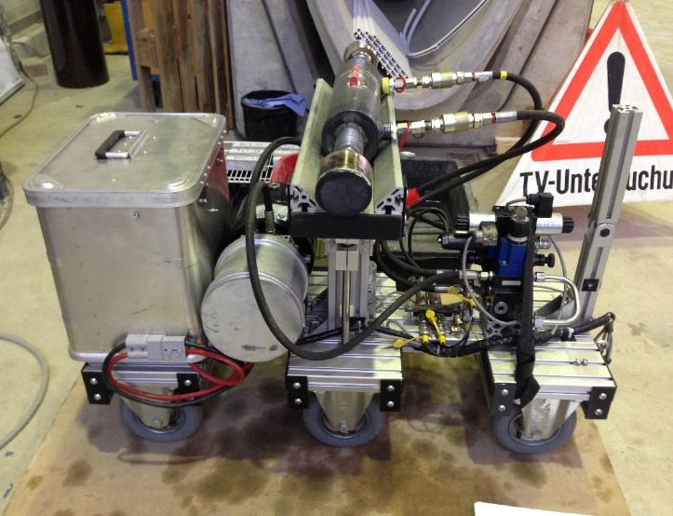
Complete Package 2/2
1
Condition assessment
of the sewer
5
2
Verfication of
long-term effect
Determination of
rehabilitation
4
3
Verfication of
rehabilitation
Monitoring of
rehabilitation
Notes:
To summarise briefly:
The MAC system supports you in assessing the condition of the sewer.
You can then select the appropriate rehabilitation method and monitor it accordingly.
You can then assess the success of the measure.
And you can carry out recurring inspections to keep an eye on the time-dependent deterioration of the sewer.

Slide 15
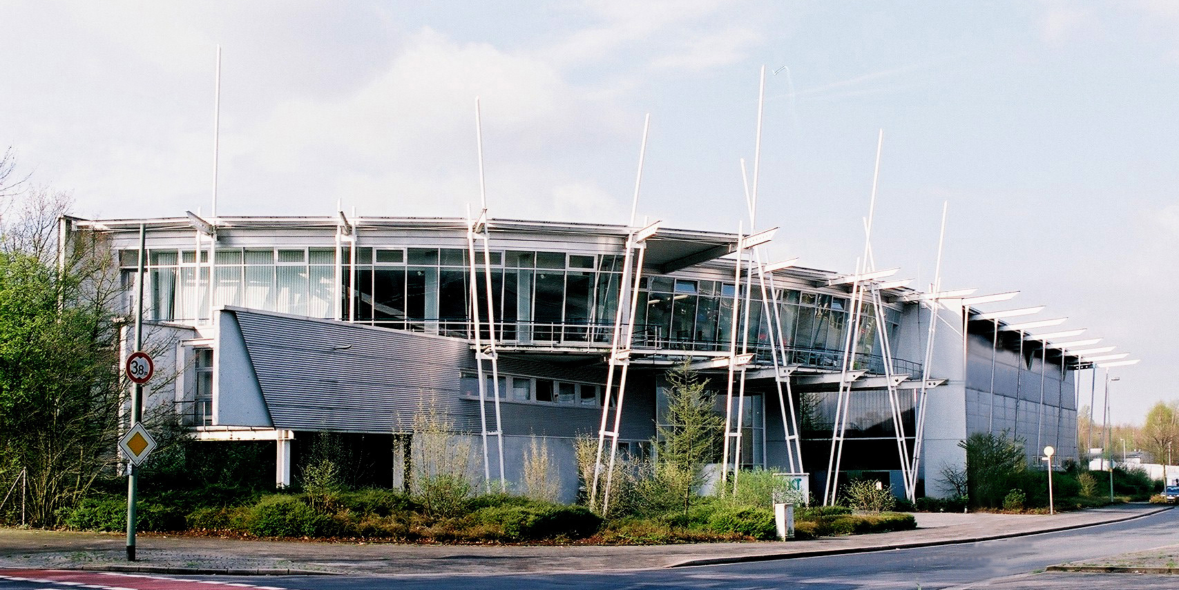

Your contact at IKT
Dr.-Ing. Mark Klameth
Tel.: 0209/17806-21
Email: klameth@ikt.de
IKT – Institute for Underground Infrastructure
Exterbruch 1
D-45886 Gelsenkirchen
Tel.: 0209/17806-0
Notes:
Thank you very much for your attention.
Any questions so far?

