Slide 1
International experiences and modern solutions in trenchless pipe renovation
ISTT – Connecting trenchless across the world.
AATT/ ÖGL – Experiences from another Trenchless Society – using the example of the Austrian Association for Trenchless Technology
A brief overview and introduction into “pipe repair” with stainless steel sleeves – using the example of the Quick-Lock systems
Place: 3325 Noszvaj, Date: 28. January 2026, Speaker: Mark André Haebler

Slide 2
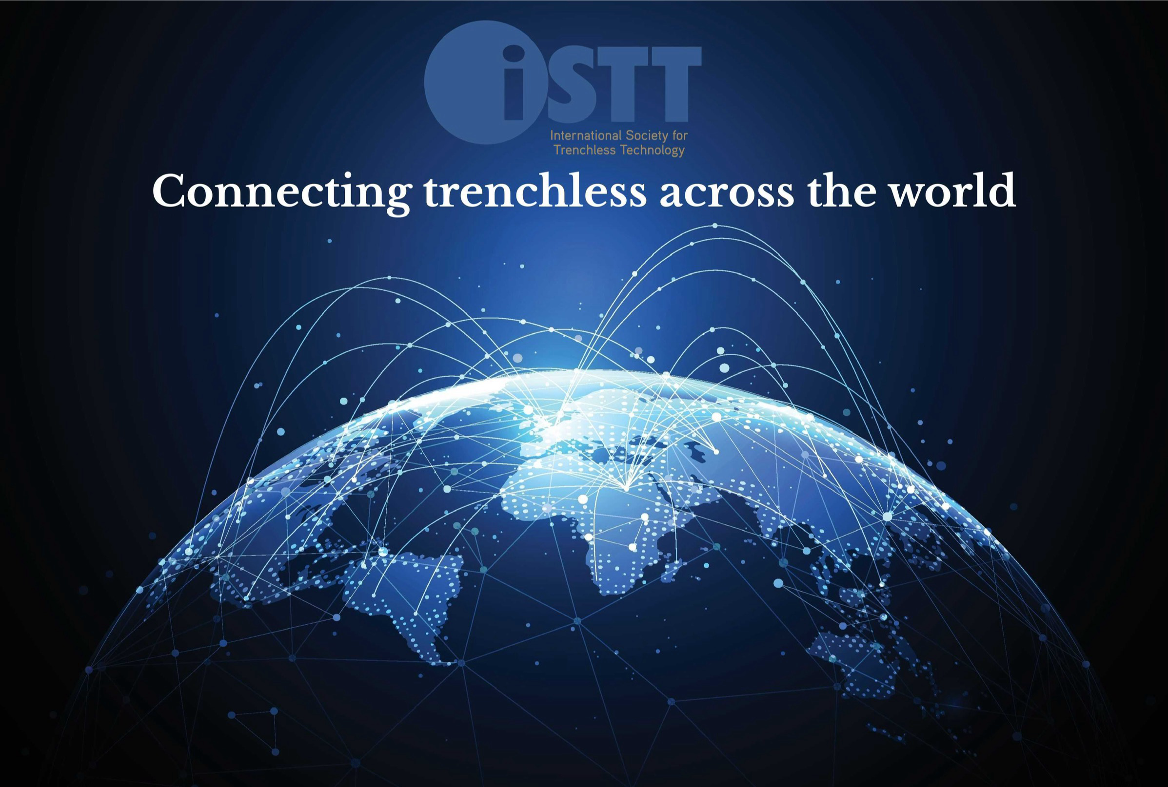

International Society for Trenchless Technology
Strategic Plan
5-Year Comprehensive Overview
2026 to 2030

Slide 3
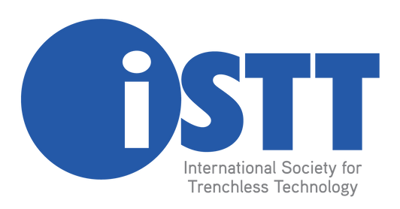
Introduction
The trenchless technology industry is entering a decisive period of opportunity. Between 2026 and 2030, global demand for sustainable, efficient, and less disruptive infrastructure solutions is forecast to rise sharply. Two technologies in particular—Horizontal Directional Drilling (HDD) and Pipe Relining—will lead this expansion, with their combined global markets projected to surpass USD 26 billion by 2030.
This positive outlook is not only a sign of growth potential but also a clear call to action. To ensure the trenchless industry can meet this global demand, the International Society for Trenchless Technology (ISTT) has prepared its 5-Year Strategic Plan (2026–2030). The plan provides a roadmap for strengthening our network, supporting innovation, developing skilled professionals, and positioning trenchless solutions as central to global infrastructure development.
Why now?
The next five years will be critical in ensuring the trenchless industry is prepared for this surge in demand. Without coordinated action, the industry risks falling short of its potential.
The ISTT Strategic Plan (2026–2030) has therefore been prepared to:
- Harness growth opportunities in HDD, relining and other trenchless technologies by supporting knowledge exchange across member societies.
- Develop capacity through training, certification, and professional development to meet the rising demand for skilled trenchless practitioners.
- Foster innovation by promoting collaboration between industry, academia, and technology developers.
- Advocate globally for the recognition of trenchless solutions as sustainable, cost-effective infrastructure methods.

Slide 4
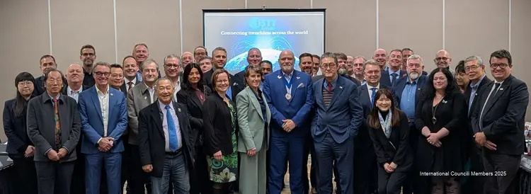
Welcome to ISTT
The International Society for Trenchless Technology (ISTT) plays a pivotal role in promoting trenchless technologies worldwide, fostering innovation and collaboration among industry professionals and stakeholders.
The International Society for Trenchless Technology (ISTT) was established in September 1986 as a United Kingdom private limited company with the object "to advance the science and practice of trenchless technology for the public benefit..." and "to promote education, training, study and research in the said science and practice for the public benefit, and to publish the useful results of the same." In the years that followed, ISTT affiliated with regional trenchless societies located throughout the world to advance these objectives globally.
ISTT has 28 Affiliated Societies. All recorded members of an Affiliated Society are members of ISTT. In addition to Affiliated Society members, ISTT has a limited number of direct members who reside in regions where no Affiliate Society exits.

Slide 5

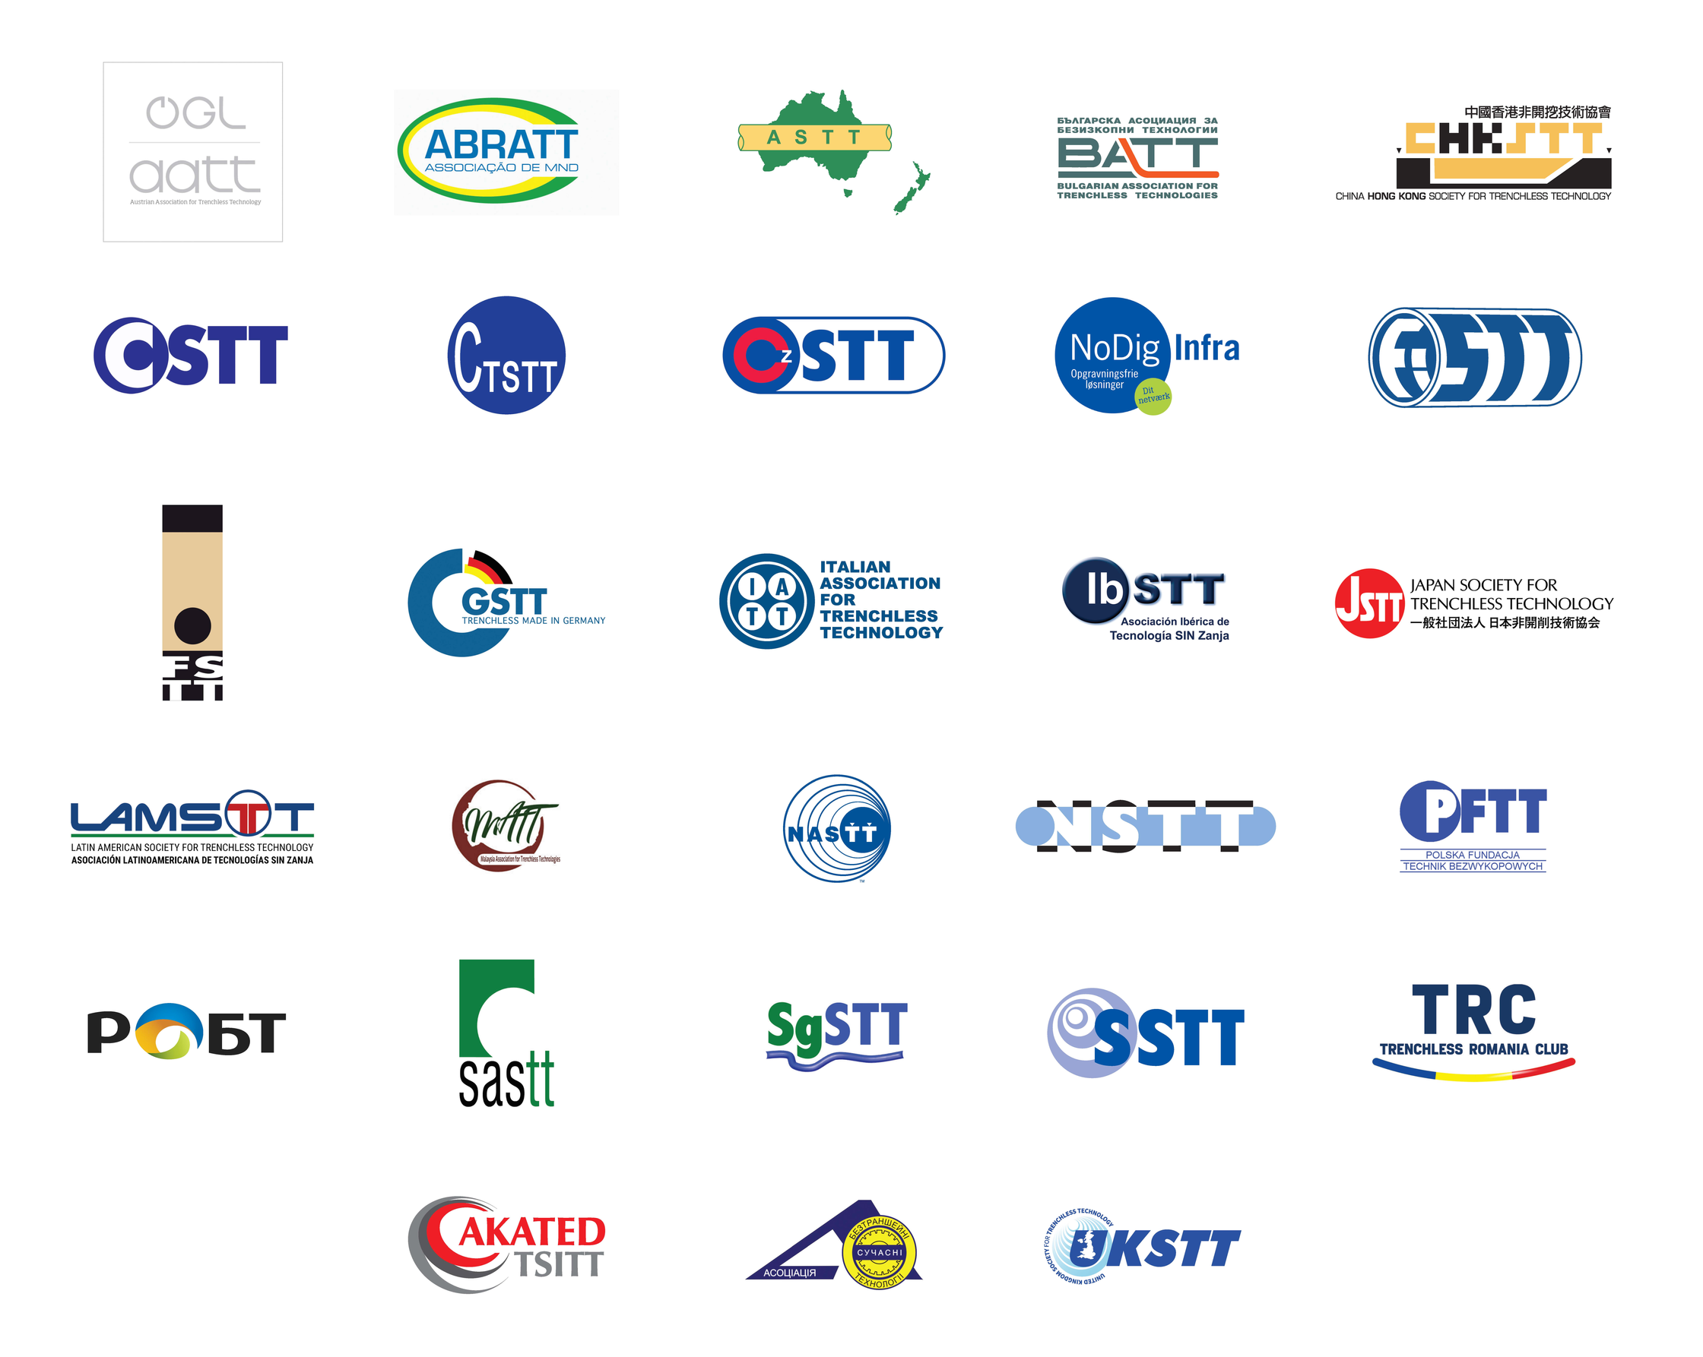
Key Goals
The ISTT 5-year strategic plan sets clear expectations for our community, focusing on innovation, collaboration, and growth, ensuring we effectively meet the needs of our members and stakeholders.

Slide 6
Current Status and Achievements of ISTT
The International Society for Trenchless Technology (ISTT) is an established and respected global organisation representing the trenchless technology industry through an extensive network of Affiliate Societies and industry stakeholders worldwide.
ISTT has played a long-standing leadership role in promoting trenchless technology through international collaboration, knowledge sharing, and advocacy. The Society is widely recognised for delivering International No-Dig Conferences and Exhibitions, which serve as key global forums for technical exchange, innovation, and industry engagement.
Through its publications, technical resources, webinars, and communication platforms, ISTT supports the dissemination of best practice and advances awareness of trenchless solutions across both mature and emerging markets.
ISTT operates as a stable and well-governed international association, providing a strong organisational foundation to support its members and future initiatives. The Society is also recognised for promoting trenchless technology as a sustainable approach to underground infrastructure, aligned with global environmental and social objectives.
These achievements position ISTT as a credible global voice for trenchless technology and provide a solid platform for continued leadership and industry development.

Slide 7
Vision and Mission of the Plan
ALIGNING OUR VISION WITH STRATEGIC GOALS
The 5-year strategic plan is vital for guiding ISTT toward achieving its mission. By aligning our vision, we ensure focused efforts and enhanced outcomes, benefiting our members and stakeholders.
Vision
Leading trenchless technology throughout the world
We are the global connection for trenchless technology
Mission
Influence and support industry worldwide to realise the benefits of trenchless technology.
Advocate trenchless as the standard method for underground infrastructure

Slide 8
Key Values
The ISTT will promote the advancement of trenchless technology worldwide by being:
Ethical
Innovative
Visionary
Impartial
Inclusive

Slide 9
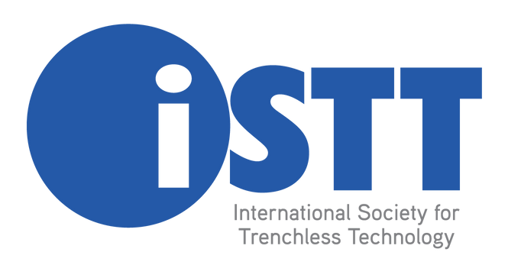
Key Focus Areas for ISTT
  Our Members
  Promotion
  Training & Education
  Industry Best Practice
  A Sustainable Society

Slide 10
Key Focus - Our Members
The Key Focus Items as identified for - Our Members
  INCREASE AFFILIATE SOCIETY MEMBERSHIP GROWTH
  IMPROVE MEMBERSHIP BENEFITS FOR CORPORATE MEMBERS OF MEMBER SOCIETIES
  IMPROVE MEMBERSHIP BENEFITS FOR INDIVIDUAL MEMBERS OF MEMBER SOCIETIES
  PROVIDE SUPPORT FOR REGIONAL GROUPINGS OF MEMBER SOCIETIES
  IMPROVE MEMBER COMMUNICATIONS
  SUPPORT MEMBER EVENTS
  DATABASE MANAGEMENT

Slide 11
Key Focus - Promotion
The Key Focus Items as identified for - Promotion
  WEBSITE
  ISTT BRAND
  INTERNATIONAL NO DIG CONFERENCES & EXHIBITIONS
  SECOND TIER ISTT TECHNICAL CONFERENCES
  E-NEWSLETTERS
  MAGAZINE
  VIDEO MEDIA CHANNEL
  NEWSLETTERS (INTERNAL)
  PROMOTE OTHER MEDIA
  ADVOCATE THE BENEFITS OF TRENCHLESS TECHNOLOGY

Slide 12
Key Focus - Training & Education
The Key Focus Items as identified for -
Training & Education
  ESTABLISH A TRAINING BUSINESS UNIT
  PROMOTE TRENCHLESS RESOURCES ON WEBSITE
  WEBINARS
  CONDUCT TRENCHLESS FORUMS
  DEVELOPING & UPDATING TRAINING MATERIALS
  ENGAGEMENT WITH UNIVERSITY/TERTIARY INSTITUTIONS FOR TRENCHLESS LEARNING

Slide 13
Key Focus - Industry Best Practice
The Key Focus Items as identified for - Industry Best Practice
  PROMOTE ISTT AWARDS
  DEVELOP A MAP OF GUIDELINES, SPECIFICATIONS & STANDARDS
  DEVELOP AN INTERNATIONAL MAP OF TRAINING & EDUCATION PROGRAMS
  PROVIDE TOOLS FOR MEMBERS DELIVERING VALUE

Slide 14
Key Focus - A Sustainable Society
The Key Focus Items as identified for - A Sustainable Society
  REVIEW OUR ORGANISATIONAL STRUCTURE
  MAINTAIN FINANCIAL EXCELLENCE & STRONG GOVERNANCE
  OPERATE IN AN ETHICAL AND TRANSPARENT WAY FOR OUR MEMBERS
  INVEST IN PROJECTS TO ACHIEVE OUR GOALS
  HAVE ROBUST BUSINESS & GROWTH PLANS
  CONSIDER PARTNERSHIPS WITH OTHER INDUSTRY SOCIETIES AND ASSOCIATIONS

Slide 15

Contact Information
TREVOR GOSATTI - EXECUTIVE DIRECTOR
gosatti@istt.com
REG. OFFICE: 8 WOLVERTON ROAD, SMITTERFIELD, STRATFORD-UPON-AVON, CV37 0HB, UNITED KINGDOM
WEBSITE
www.istt.com

