Slide 1
International experiences and modern solutions in trenchless pipe renovation
ISTT – Connecting trenchless across the world.
AATT/ ÖGL – Experiences from another Trenchless Society – using the example of the Austrian Association for Trenchless Technology
A brief overview and introduction into “pipe repair” with stainless steel sleeves – using the example of the Quick-Lock systems
Place: 3325 Noszvaj, Date: 28. January 2026, Speaker: Mark André Haebler

Slide 2
Austrian Association for Trenchless Technology

Slide 3
What is that?
Competence and Dialogue Platform
active as an independent association since 1991
Members
the most important Austrian specialized civil engineering companies
municipal utilities and companies that benefit from the use of our technologies
civil engineers & planning offices
manufacturers and dealers of construction components & specialized machinery
Interested people – esp. science & research

Slide 4
Board
consist of 10 persons
chairman
two representatives from construction companies
two representatives of municipal utilities or companies that benefit from the use of our technologies
two representatives from civil engineers & planning offices
two manufacturers and dealers of construction components & specialized machinery
secretary general

Slide 5
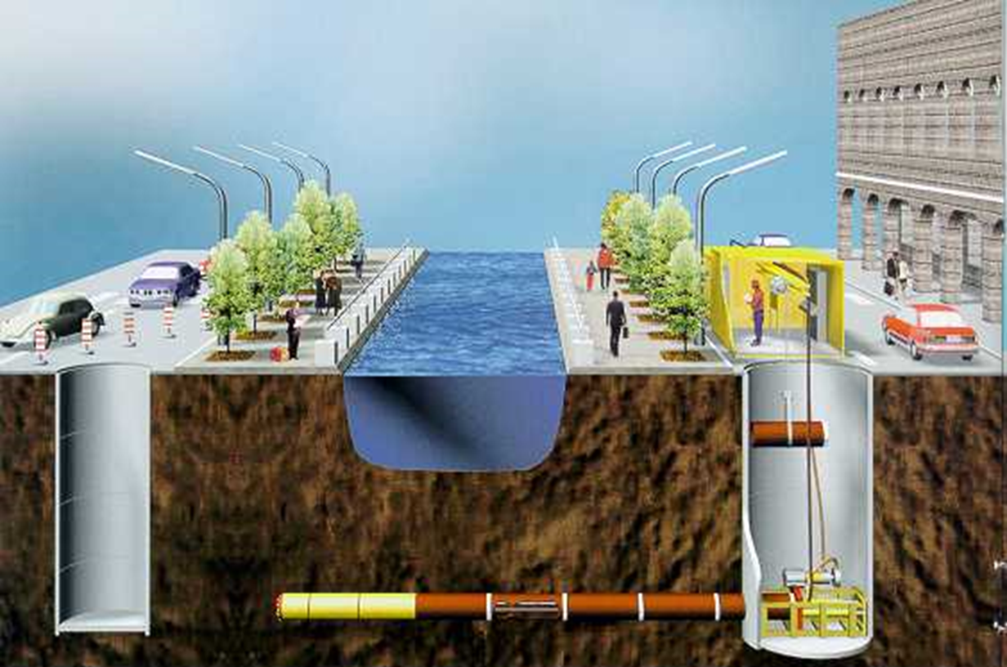

Slide 6
Why no dig?
Trenchless technologies promote active environmental protection and provide a higher quality of life for residents, clients, and communities through
short construction times,
significantly reduced CO² emissions,
less noise and fine dust pollution,
cost advantages
#sanierung #nachhaltig #grabenlos

Slide 7
Frequent Events
Roadshows
Not fixed by now for 2026 (examples following)
Continuing education events
Webinar am 24th Feb 2026 10am
EU-Trinkwasserrichtlinie (EU) 2020/2184 (EU Drinking-Water-Directive)
Modular lectures at HTL in the field of civil engineering and environmental technology
grabenlos.2026
conference with around 10 paper presentations, practical demonstrations and excursions
29th & 30th Sept. 2026
Title: No Dig & Blue-Green: Sustainable Infrastructure for Climate Resilience

Slide 8
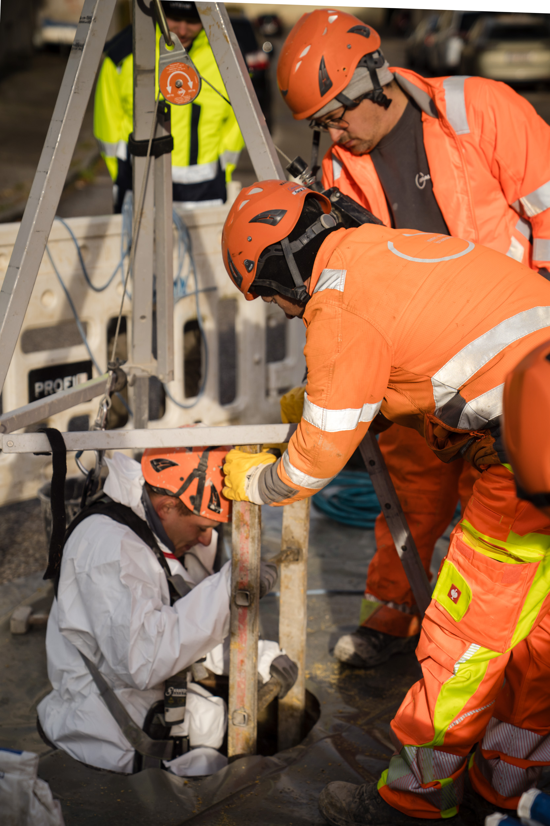
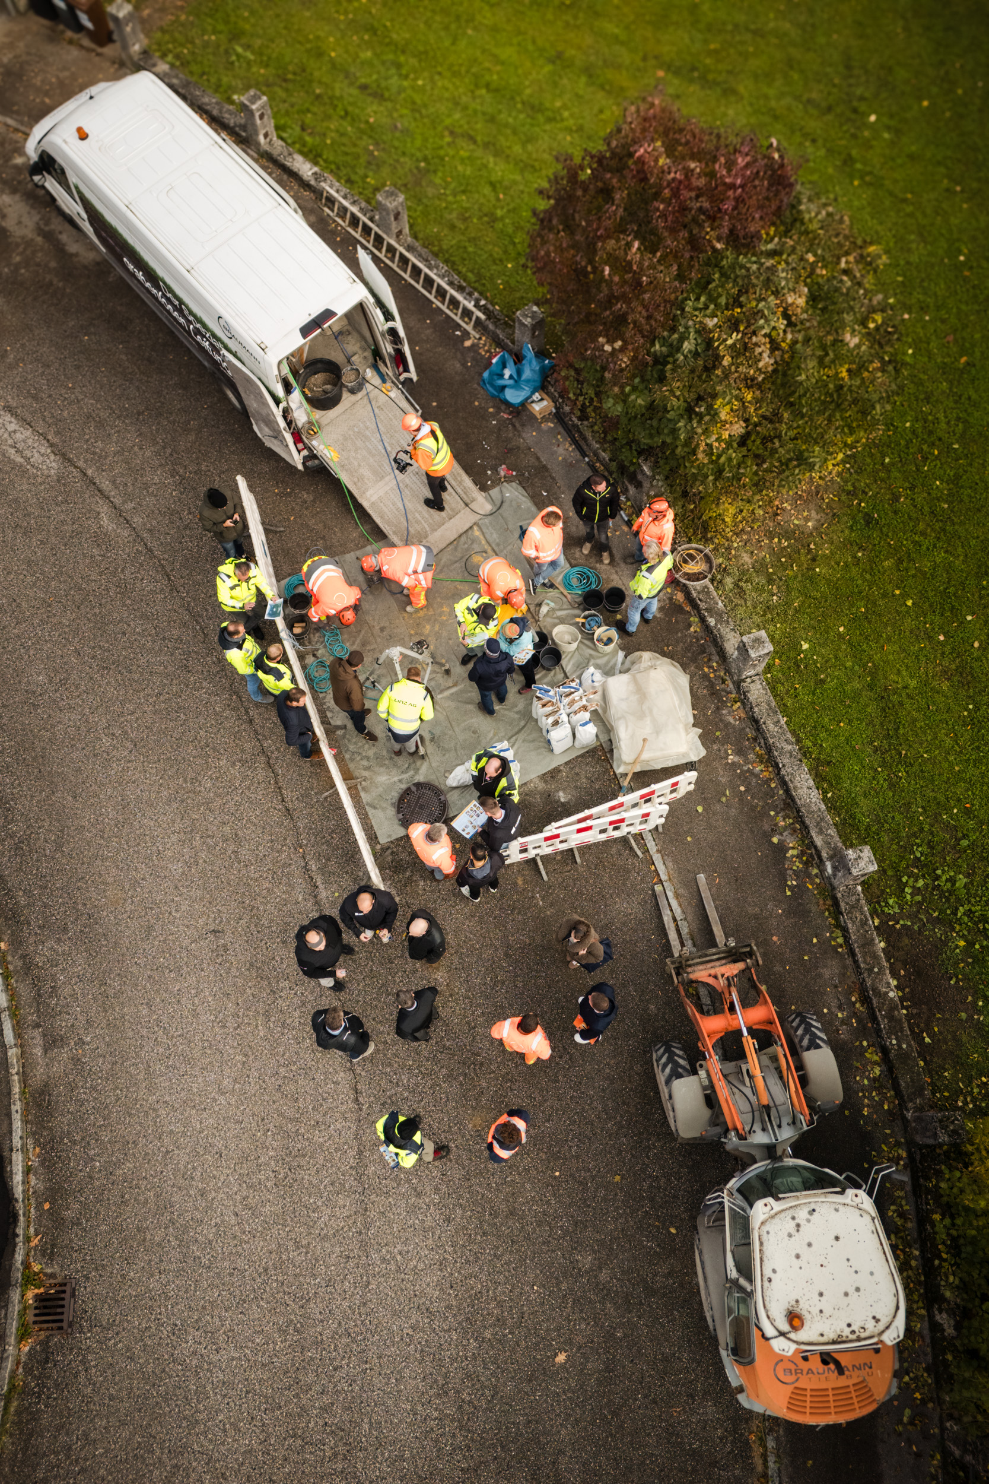
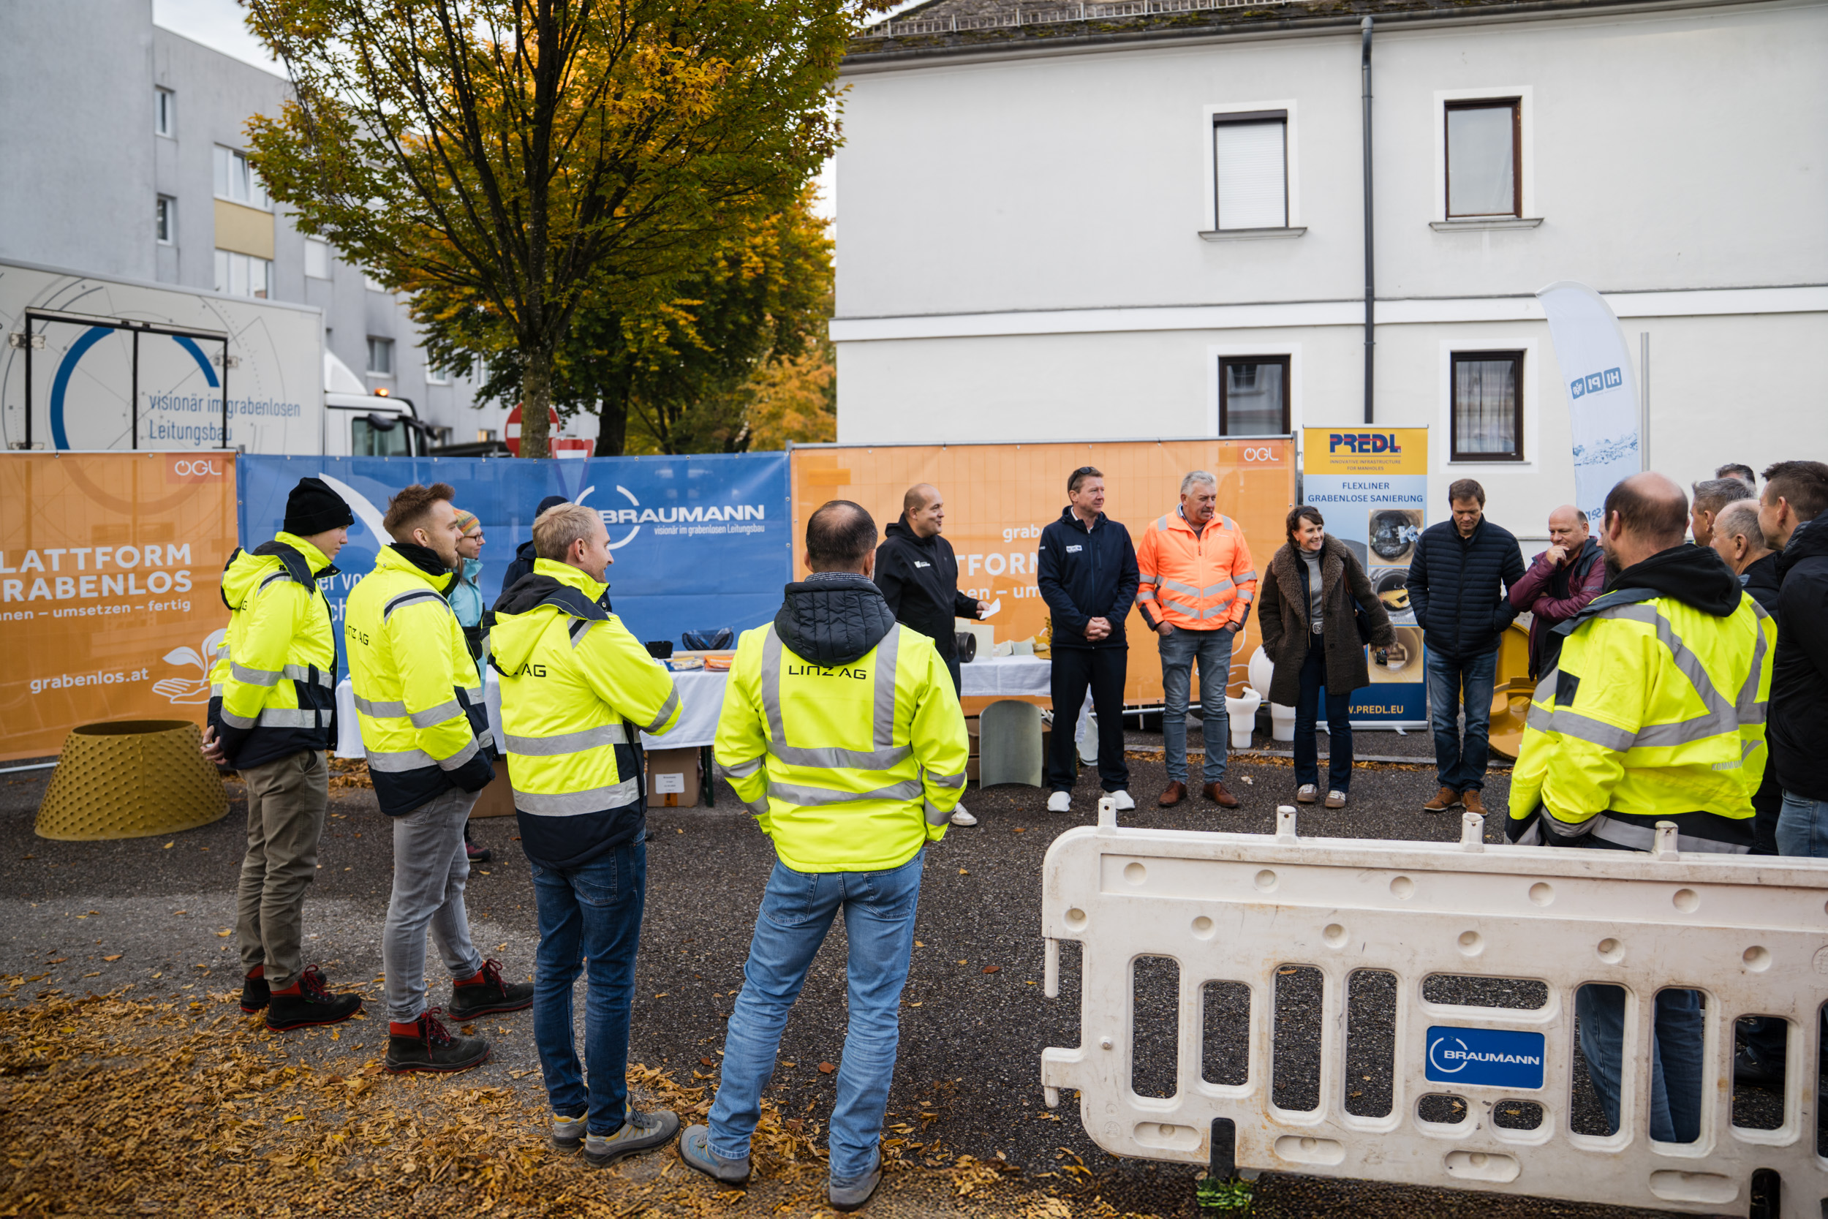
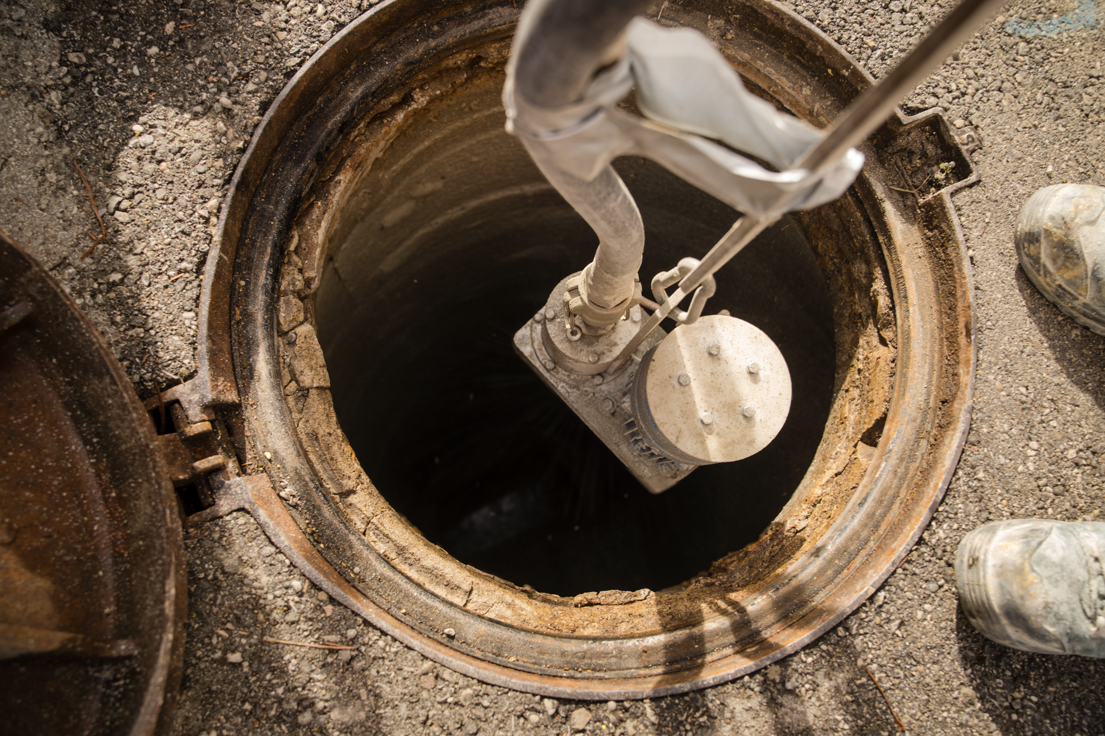
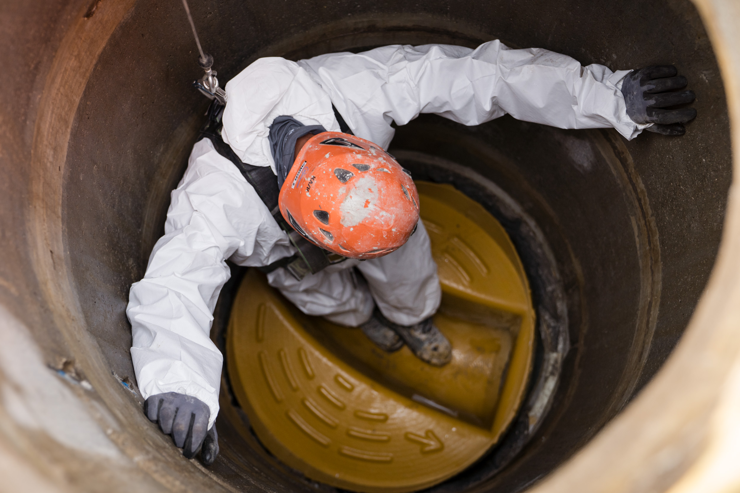
Best practices - roadshows
Civil engineer
construction companies
Manufacturer
Sight inspection

Slide 9
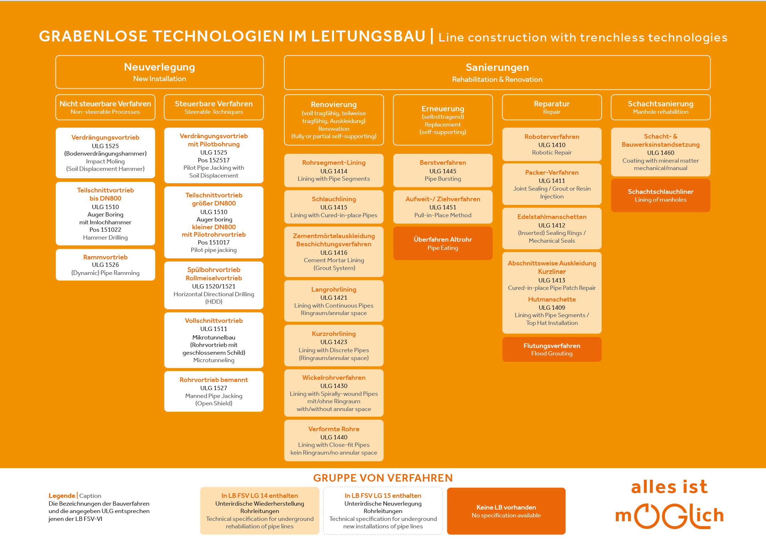
Procedure Description
all details: https://www.grabenlos.at/de/grabenlose-technologie.html

Slide 10
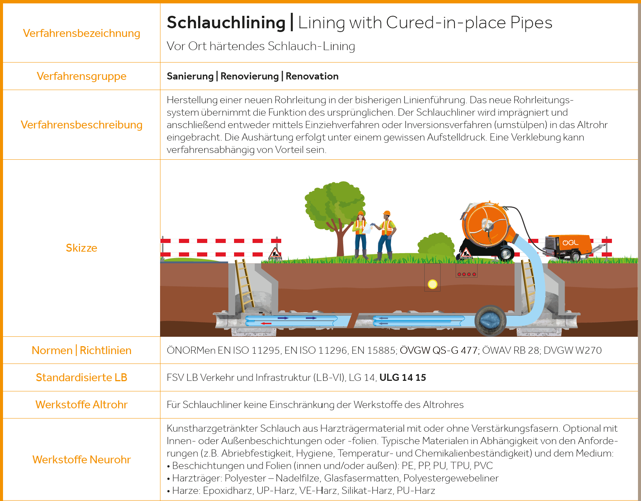

Slide 11
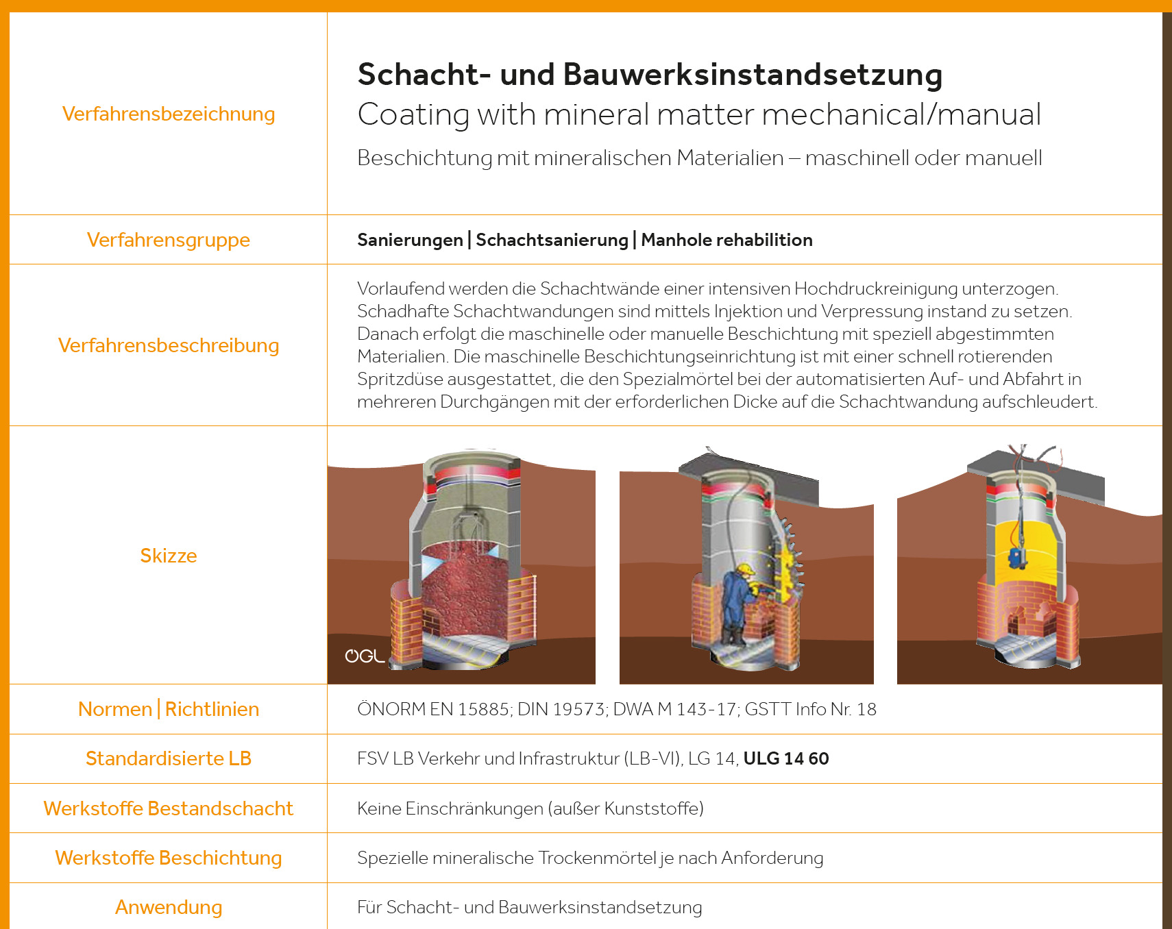

Slide 12
Key objectives of the AATT:
Promoting young talents
award presentation at grabenlos.2025
co-authorship for an HTL book
Courses at TU Wien and other universities
Teaching modules at technical schools and for young technicans in civil engineering

Slide 13
Working groups on various focuses:
AG01 | Process descriptions and technical development
AG02 | Events
AG03 | Training & Education
AG04 | Funding landscape in Austria
AG06 | CO2 savings

