Slide 1
International experiences and modern solutions in trenchless pipe renovation
ISTT – Connecting trenchless across the world.
AATT/ ÖGL – Experiences from another Trenchless Society – using the example of the Austrian Association for Trenchless Technology
A brief overview and introduction into “pipe repair” with stainless steel sleeves – using the example of the Quick-Lock systems
Place: 3325 Noszvaj, Date: 28. January 2026, Speaker: Mark André Haebler

Slide 2
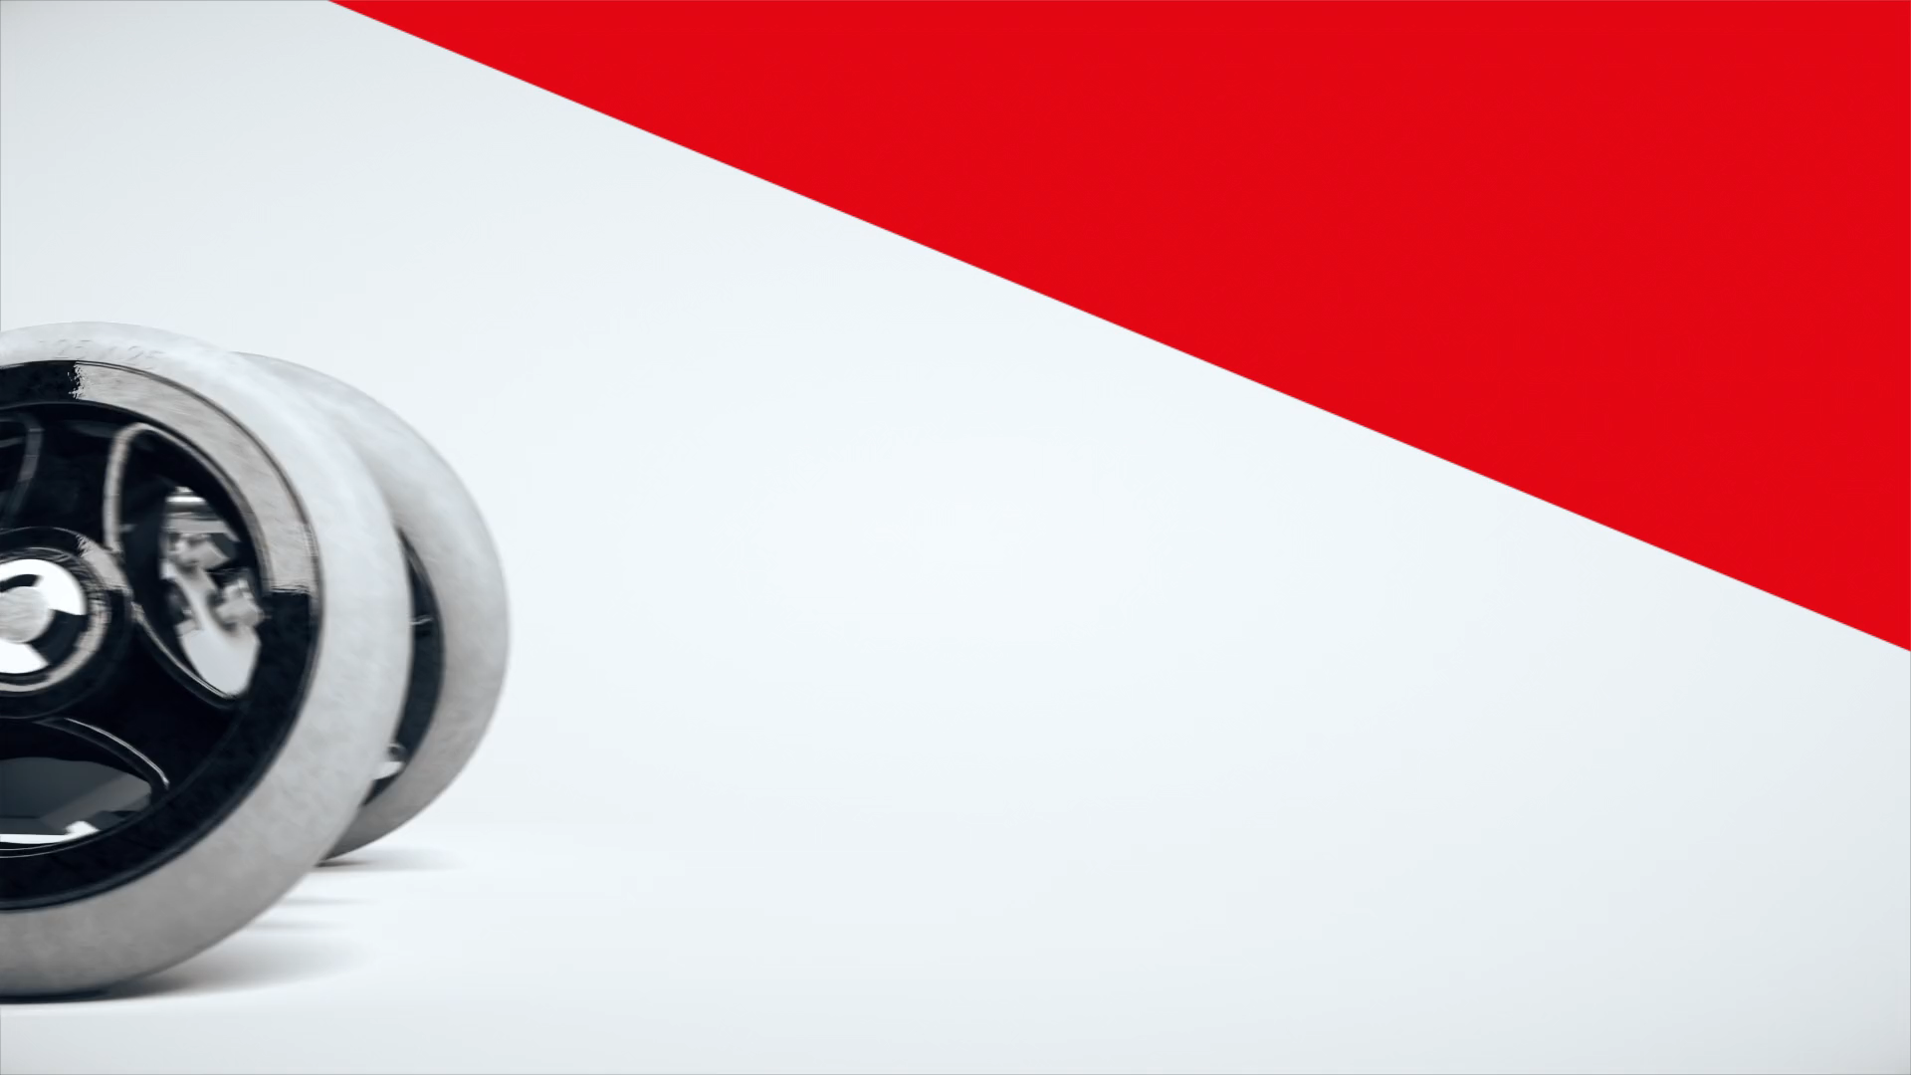

Slide 3

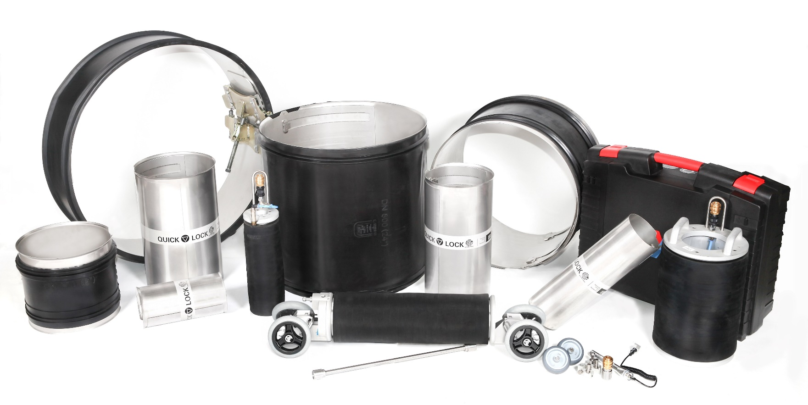
Simplicity and economic efficiency
with 30+ years experience in field
©Uhrig Kanaltechnik GmbH

Slide 4
What´s Quick-Lock and what´s NEW?
A mechanical point repair system, that can be installed with limited manpower in a matter of minutes with any CCTV crawler.
QL Standard for interior pipe diameters DN100 – DN800 as a single sleeve version
QL LEM for LinerEnd connections from DN100 – DN800 single sleeve version
QL BIG from DN800 – DN3000 in 2-, 3- or 4-part system
QL LEM BIG from DN700 - DN2400 in 2- and 3-part system
QL for pressure pipe LD and HD from DN100 – DN800
QL LEM pressure pipe LD and HD from DN100 – DN600
Notes:
Quick-Lock PRESSURE PIPE (LD+HD): DN 150 - DN 800
Quick-Lock PRESSURE PIPE: LinerEnd (LD+HD) DN 150 - DN 600

Slide 5
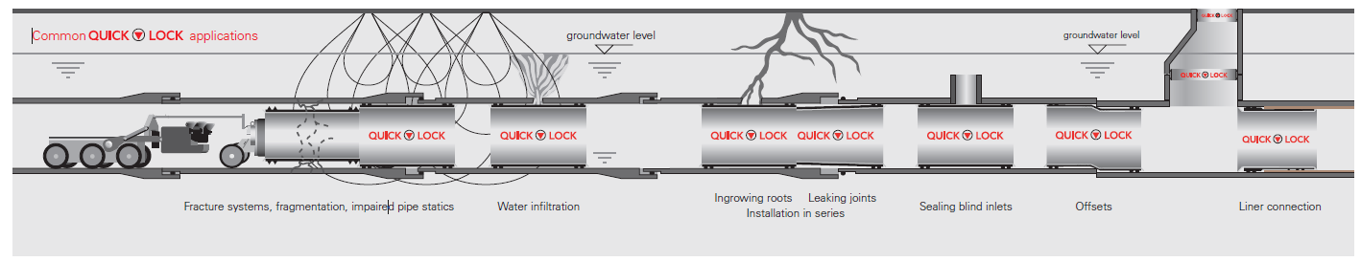

Applications for Quick-Lock
Leaks (groundwater infiltration and exfiltration)
Cracks (longitudinal, radial and transverse)
Fragmentation
Leaking joints
Displacement / offsets
Root penetration
Closing / sealing unused laterals
Corrosion / spalling / wear
Improving the structual strength of pipes
LinerEnd connections
Manhole joint repair / entry connection
©Uhrig Kanaltechnik GmbH

Slide 6
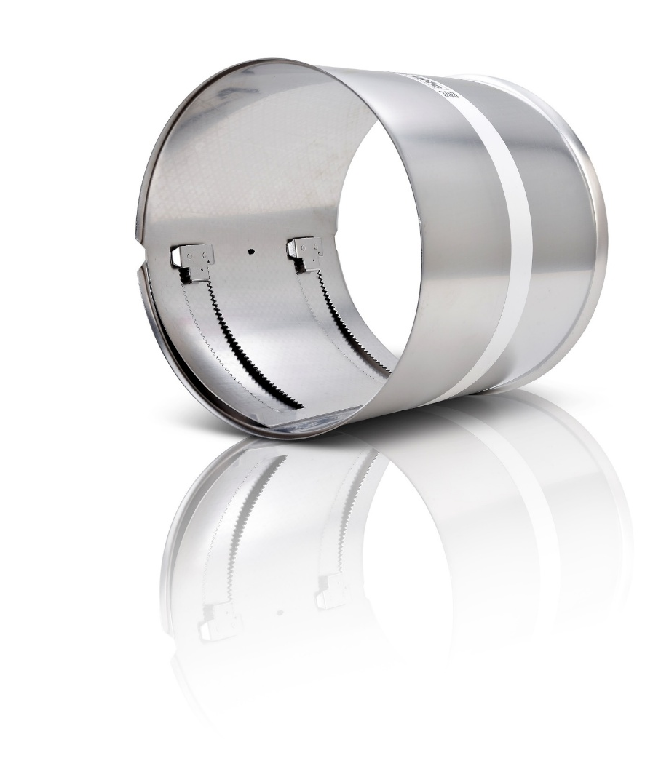
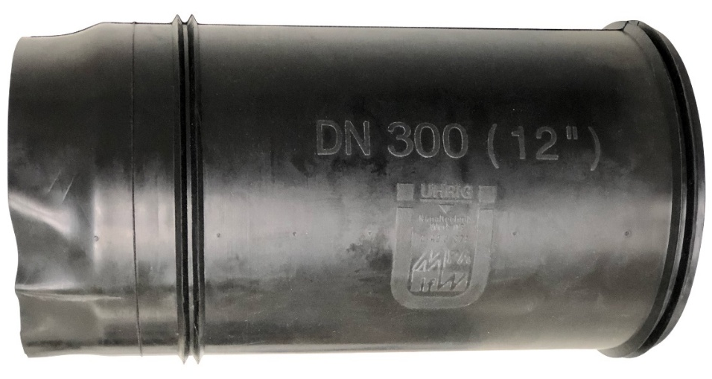
Stainless Steel Sleeve
316L stainless steel (1.4404)
Maintains high corrosion resistance - functional for both sewage and potable water.
904L stainless steel (1.4539)
Maintains seawater corrosion resistance
Seals
EPDM-Seal for sewage water
Silicone seal for potable water
NBR-Seal for oil and gas

Slide 7
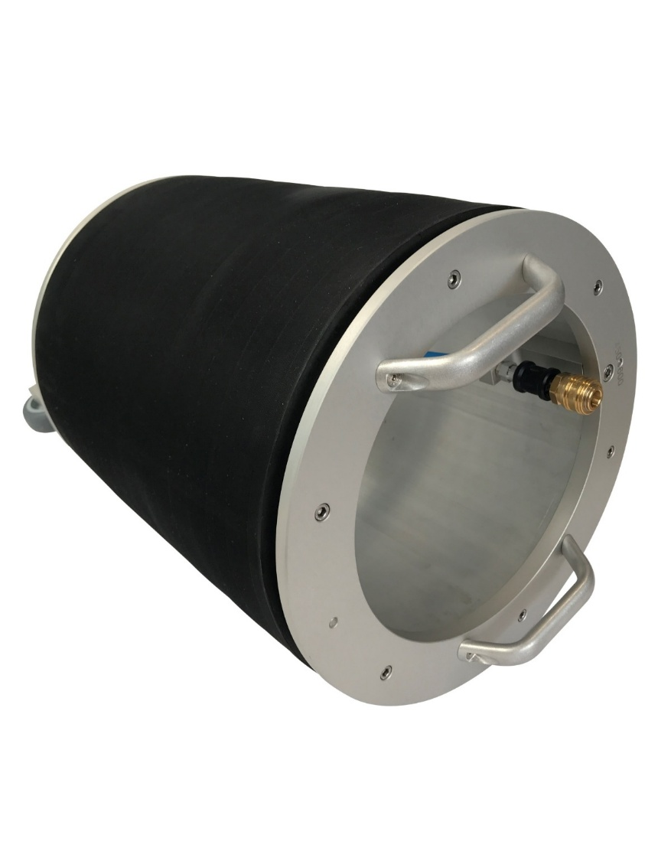
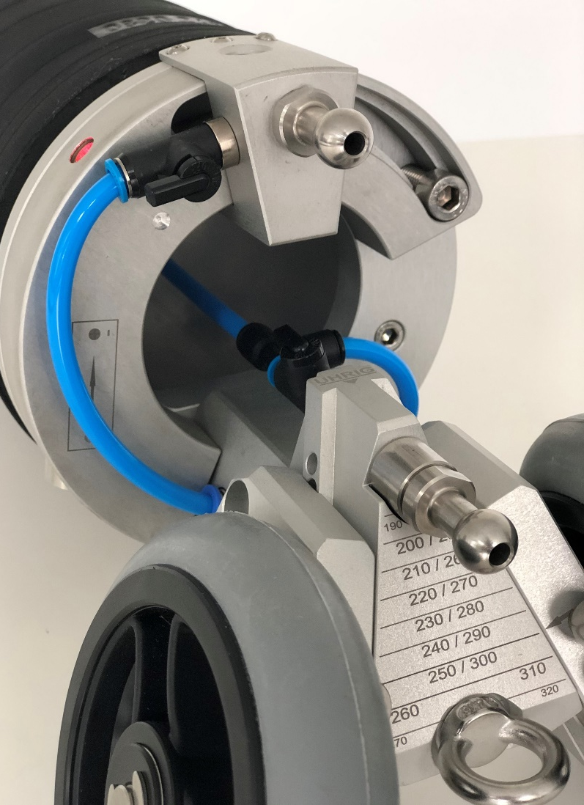
Installation packers for point repair and Installation balloons for LinerEnd
Packers provide uniform expansion pressure throughout the overall sleeve length.
Inflation of packer controlled from above ground.

Slide 8
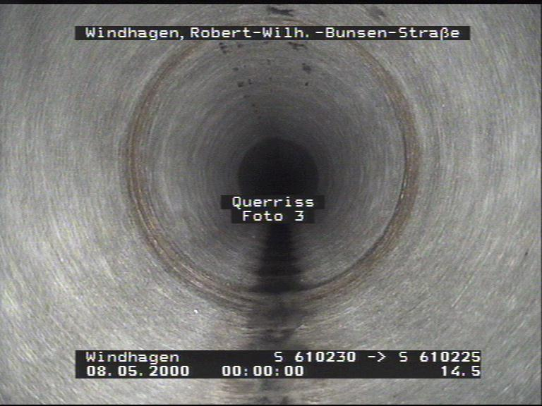
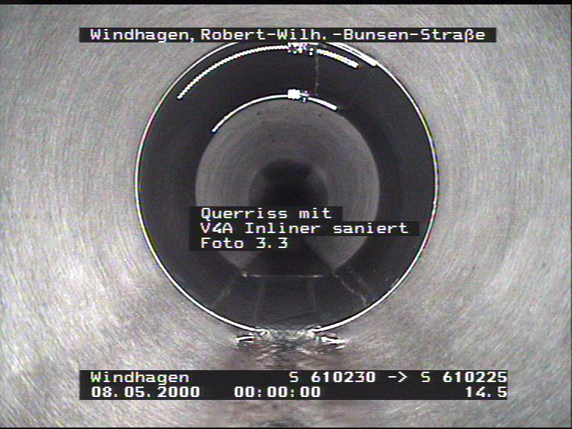
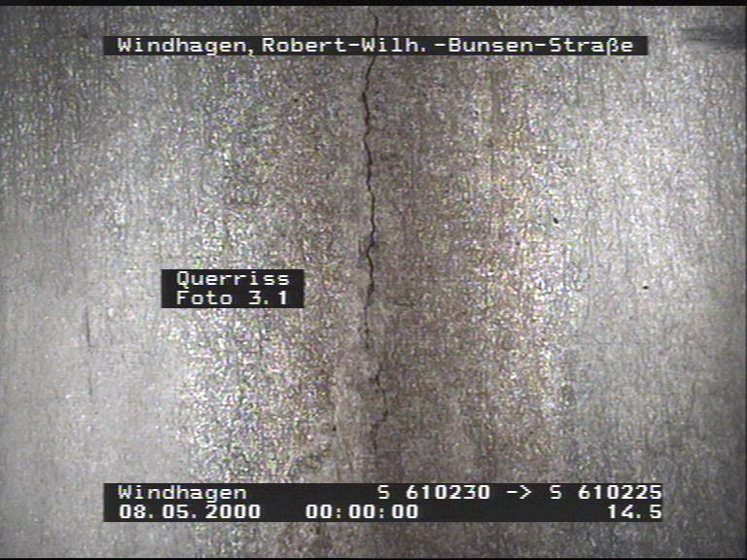
Single installation
©Uhrig Kanaltechnik GmbH
Notes:
INFO:
Baustelle Windhagen
Material:
DN:
Schadensbild: Querriss
Sonstiger Input???

Slide 9
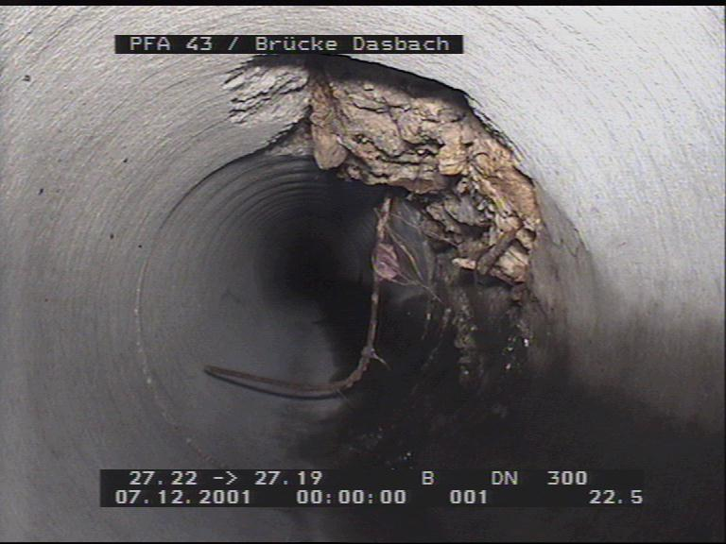
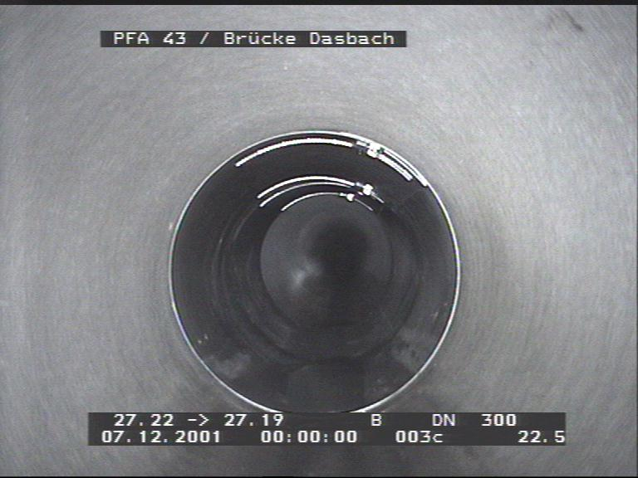
Single installation
©Uhrig Kanaltechnik GmbH
Notes:
INFO:
Baustelle Brücke Dasbach
Material:
DN 300
Schadensbild:
Sonstiger Input??? Vorbereitungen Sanierung / wie saniert?

Slide 10
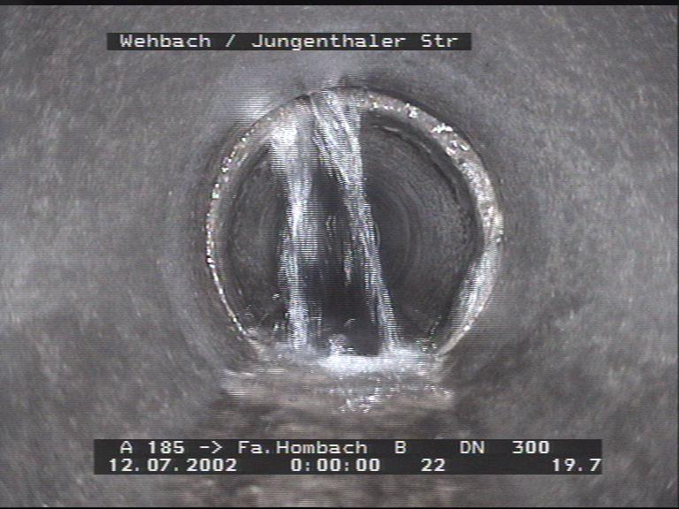
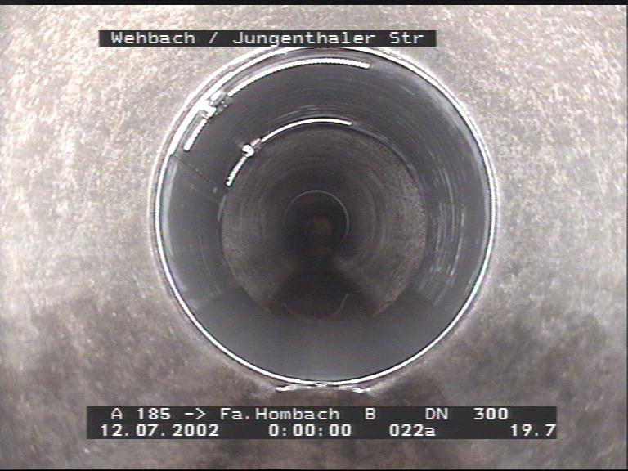
Single installation
©Uhrig Kanaltechnik GmbH
Notes:
INFO:
Baustelle Wehbach
Material:
DN 300
Schadensbild: Infiltration?
Sonstiger Input??? Vorbereitungen Sanierung / wie saniert?

Slide 11
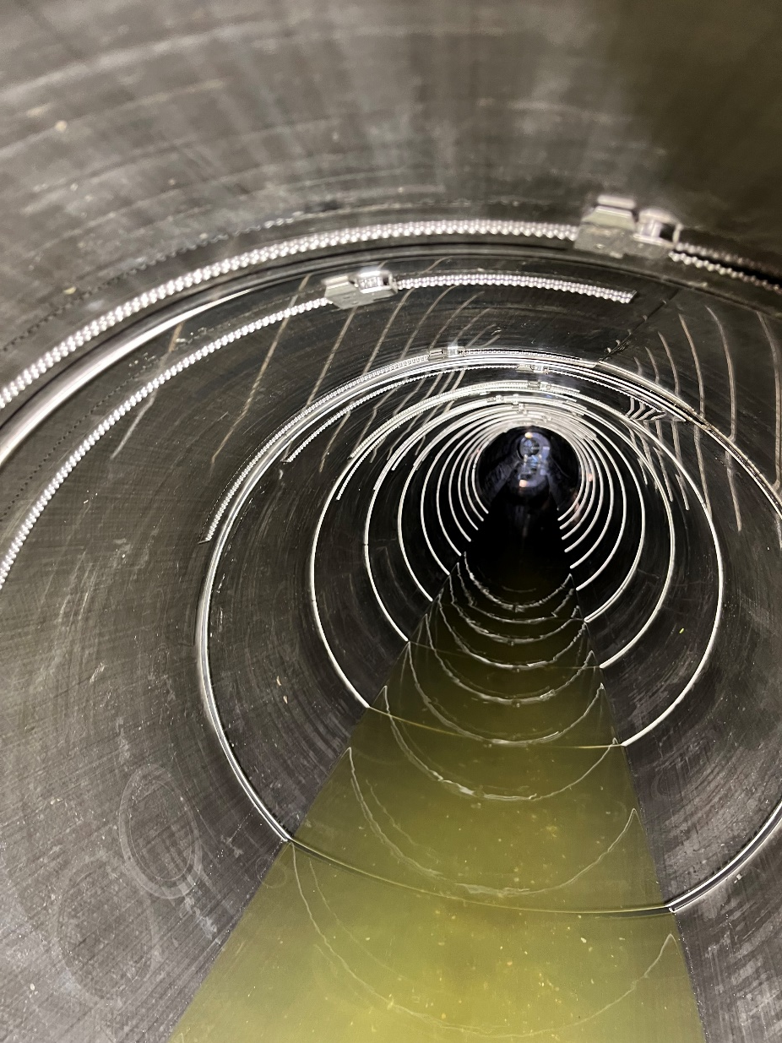
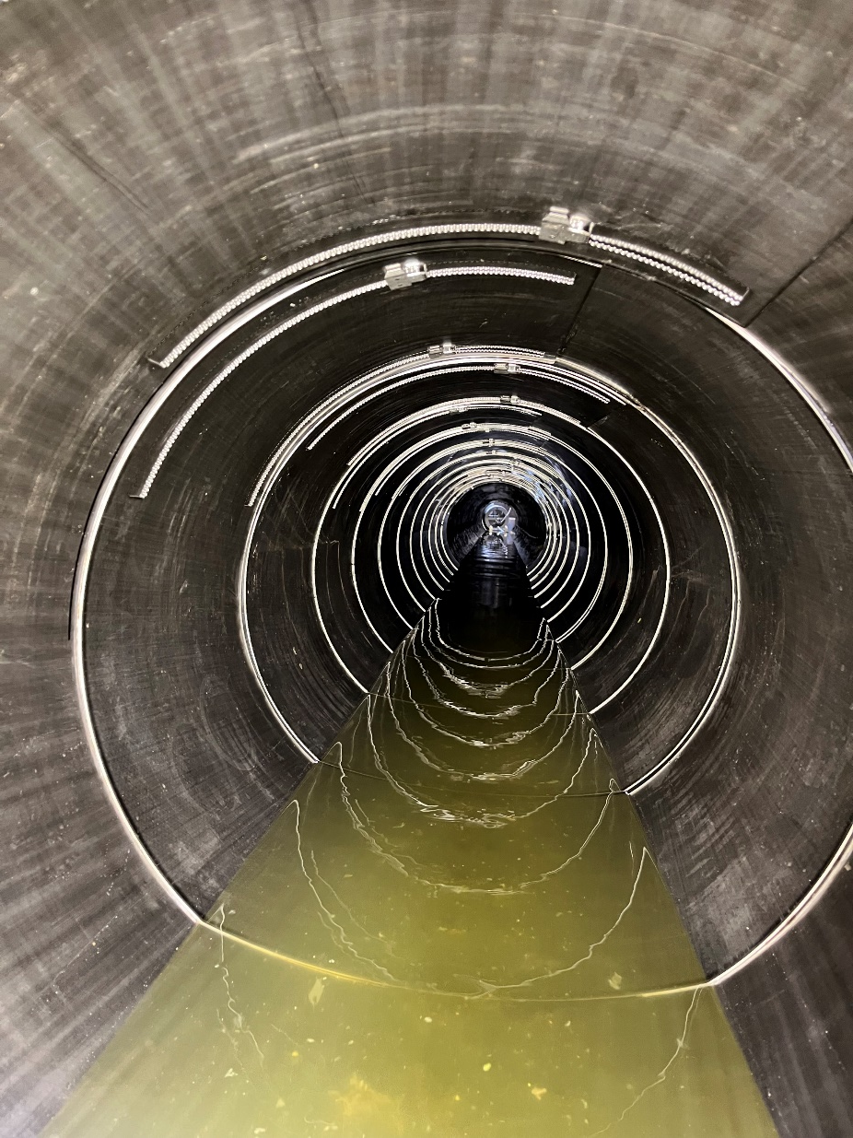
Serial installation
©Uhrig Kanaltechnik GmbH
Notes:
Müssen die ganzen Infos dazu eigentlich sein oder reichen die Bilder?
AZ-Rohre
Sohlbruch
Infiltrationen
NW DN 700 u. 800
Länge 225 m
280 x Q.L. DN 700
160 x Q.L. DN 800
4 Stutzen
Versetzdauer 6 Tage

Slide 12
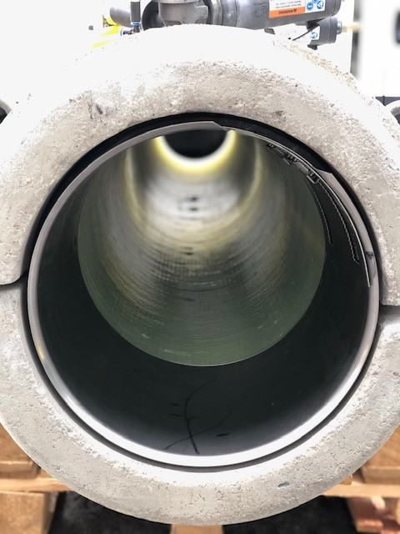
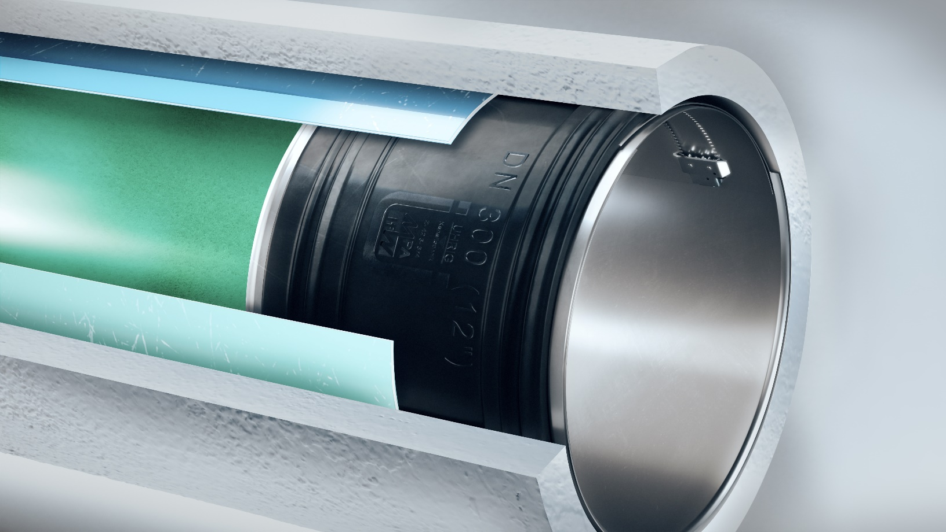

Slide 13
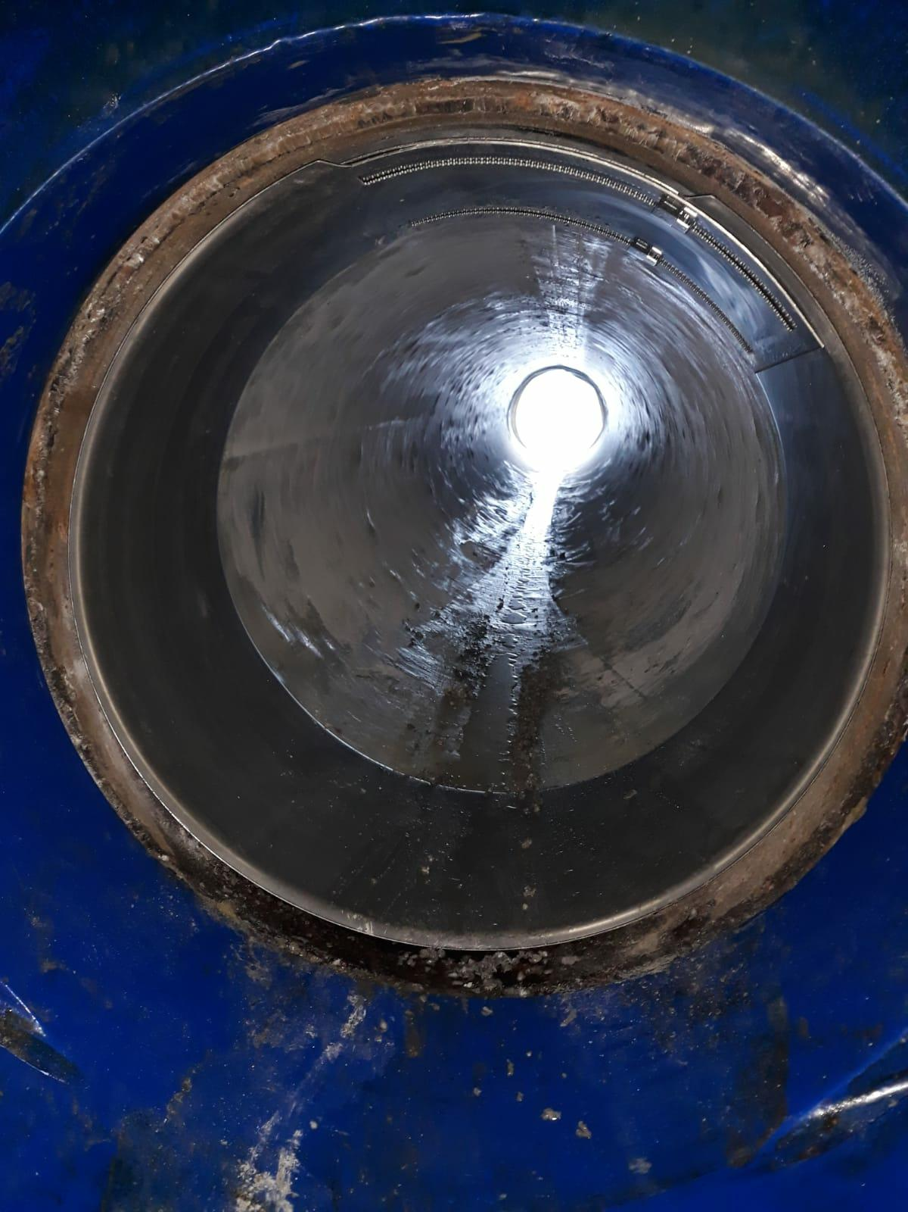
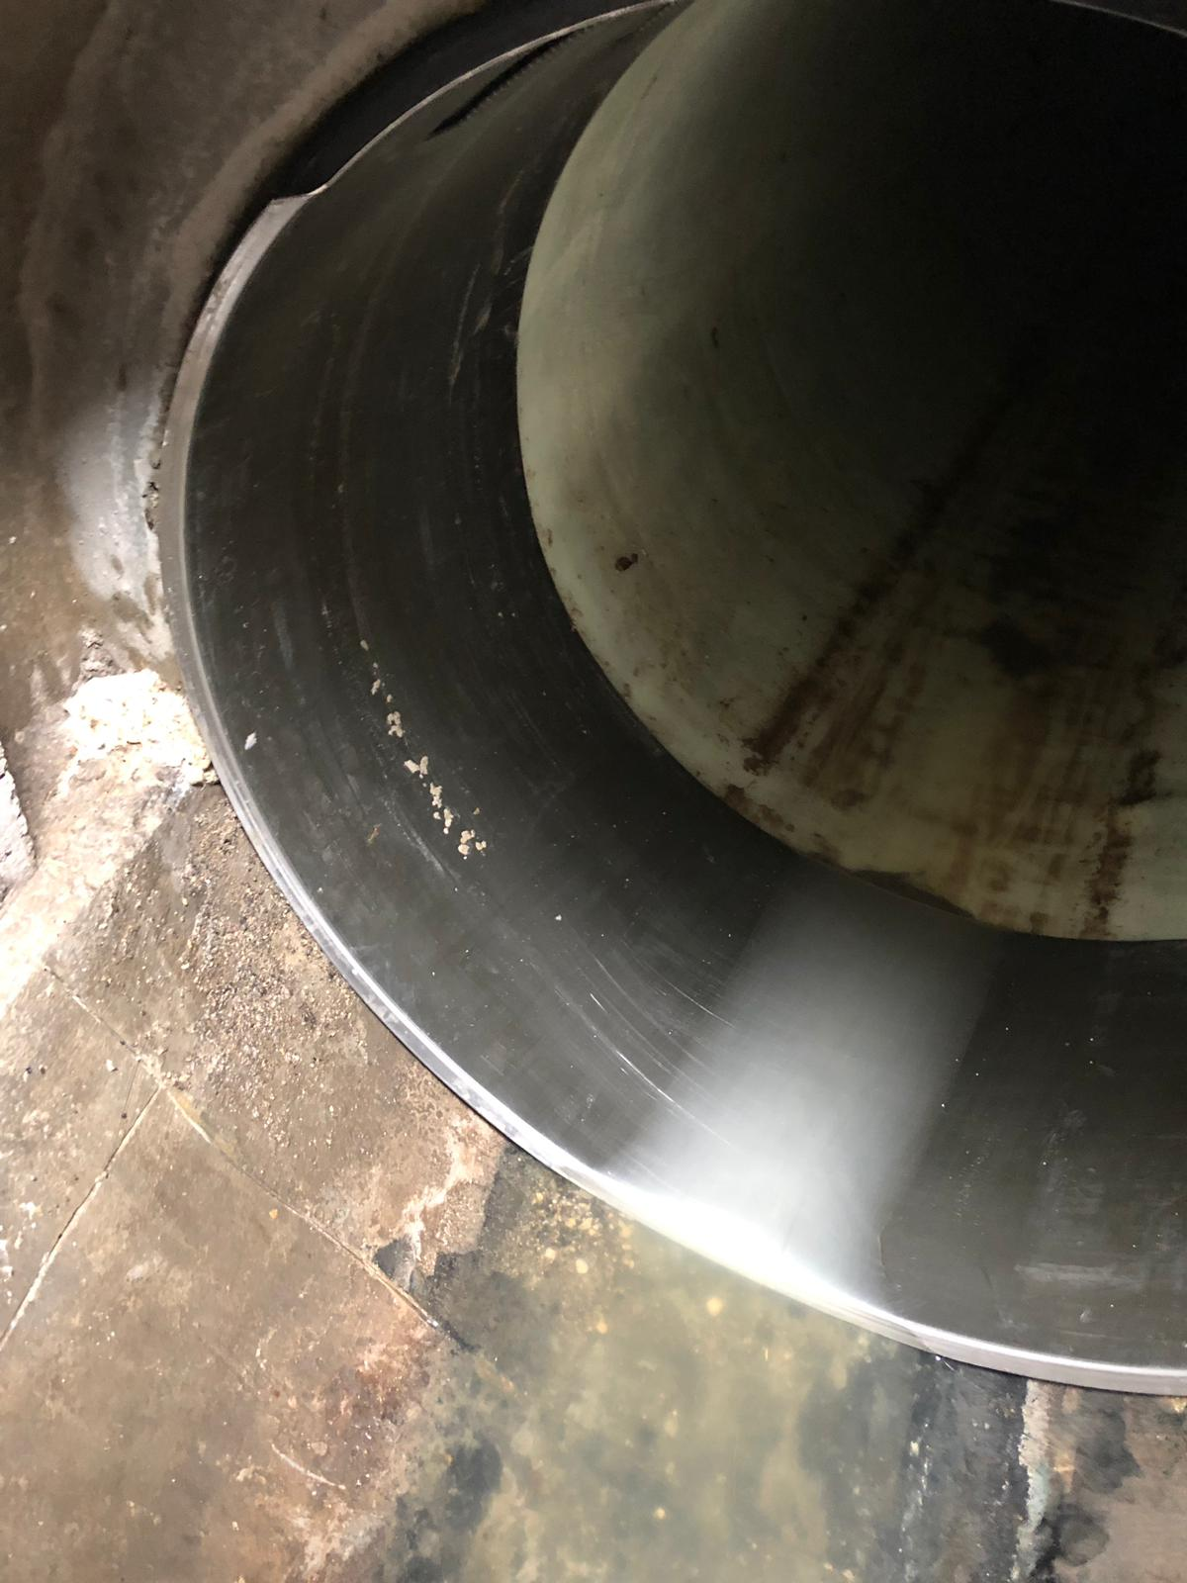
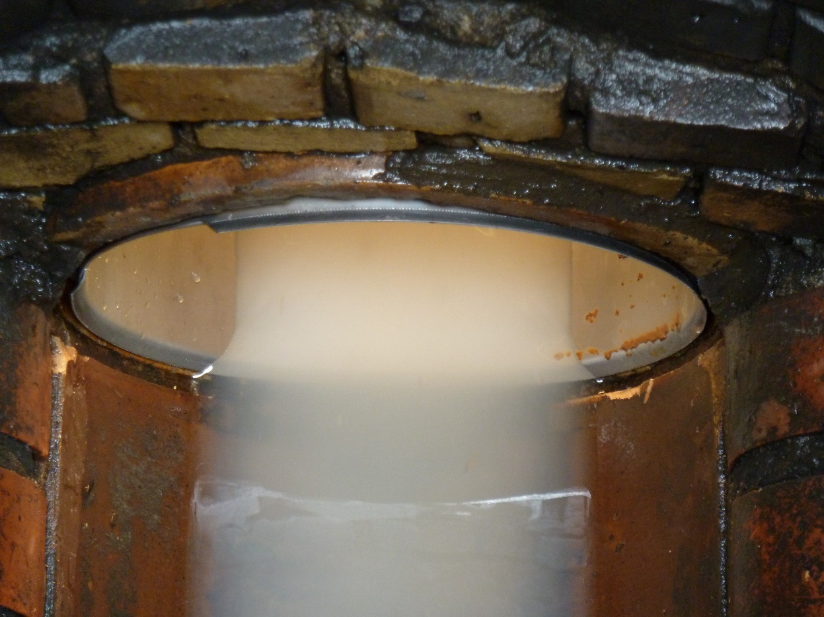
Examples construction site
©Uhrig Kanaltechnik GmbH
Notes:
Weitere Bilder? Von meiner Baustelle

Slide 14
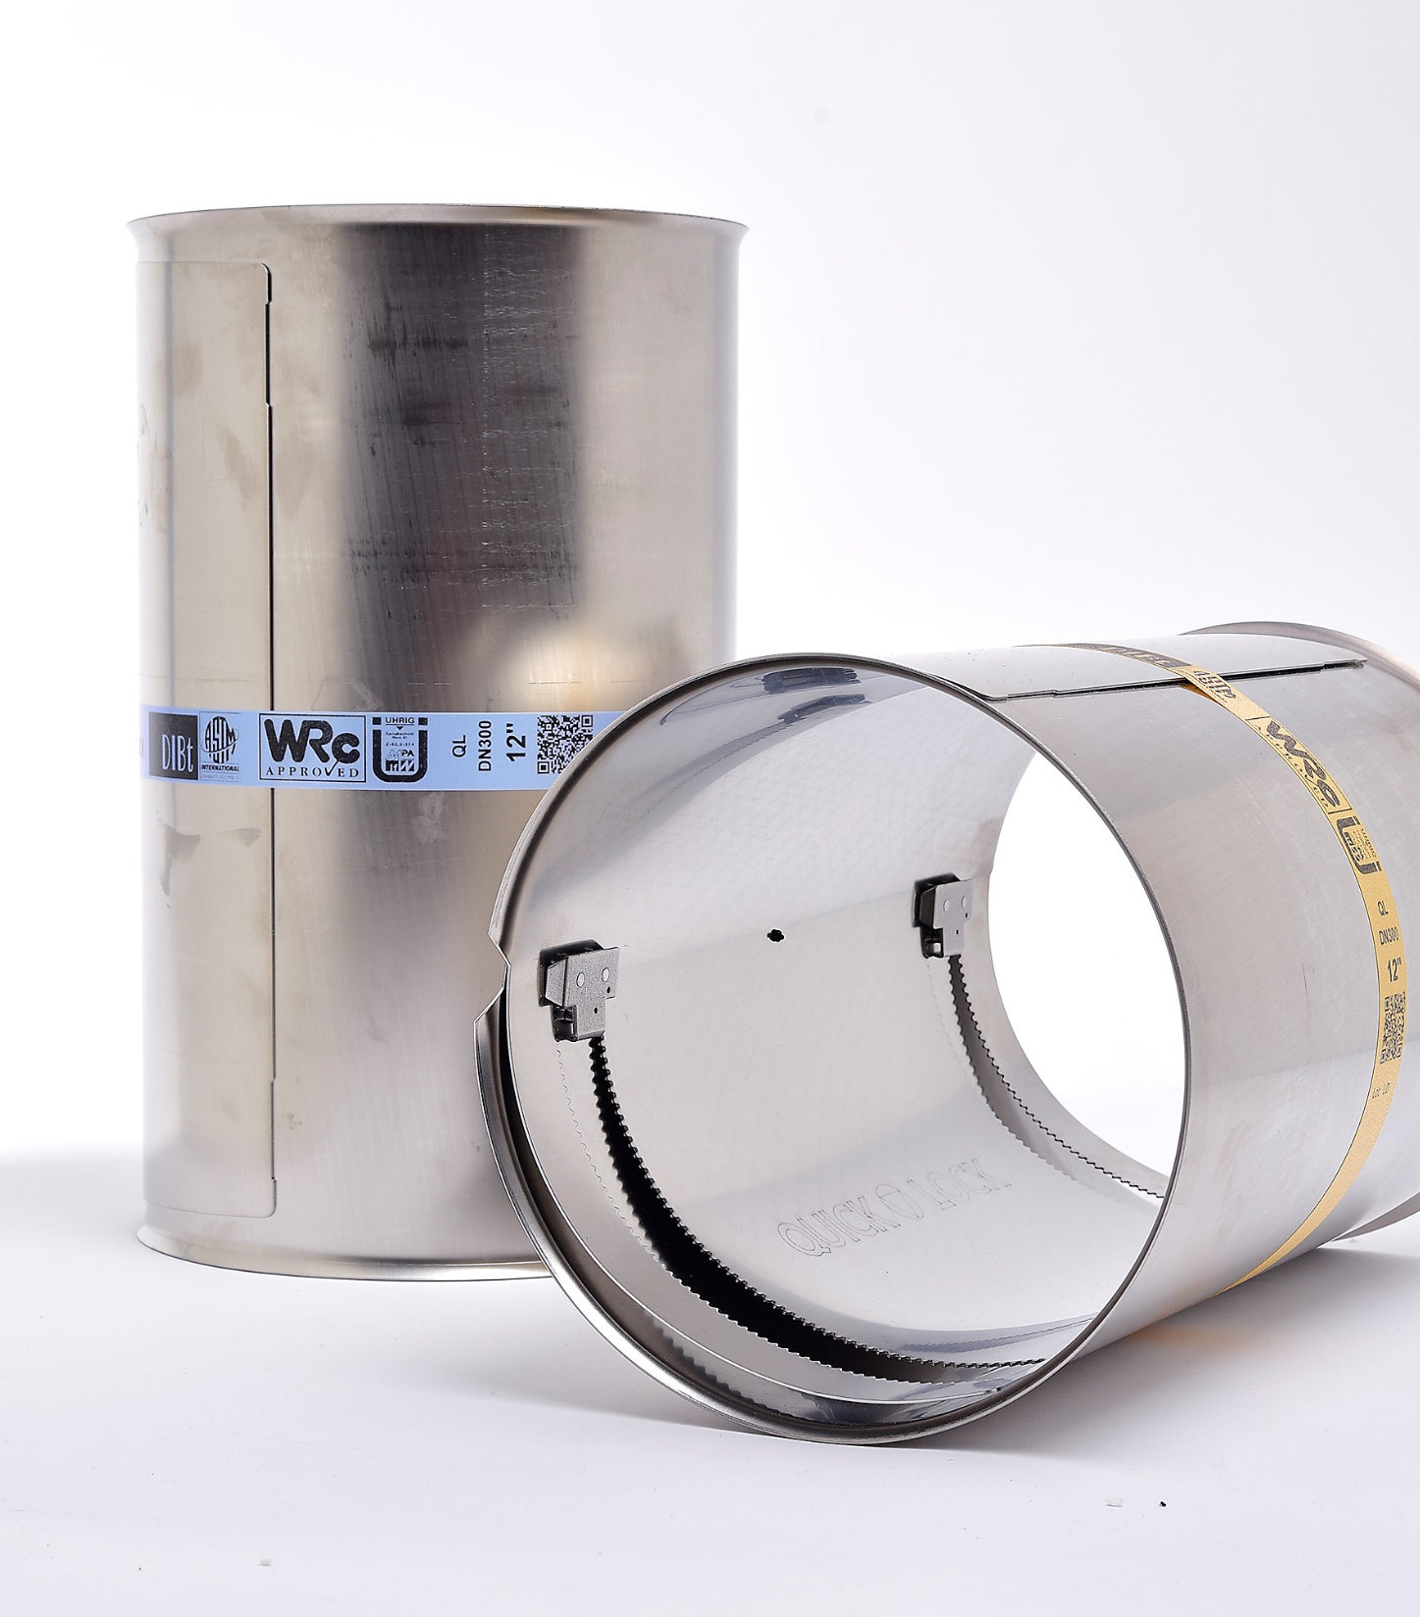
Quick-Lock
PRESSURE PIPE
LD + HD

Slide 15

Quick-Lock LinerEnd
PRESSURE PIPE
LD+HD
©Uhrig Kanaltechnik GmbH
Notes:
@Krissy
Abb. neu
Logo unten rechts nicht freigestellt.

Slide 16
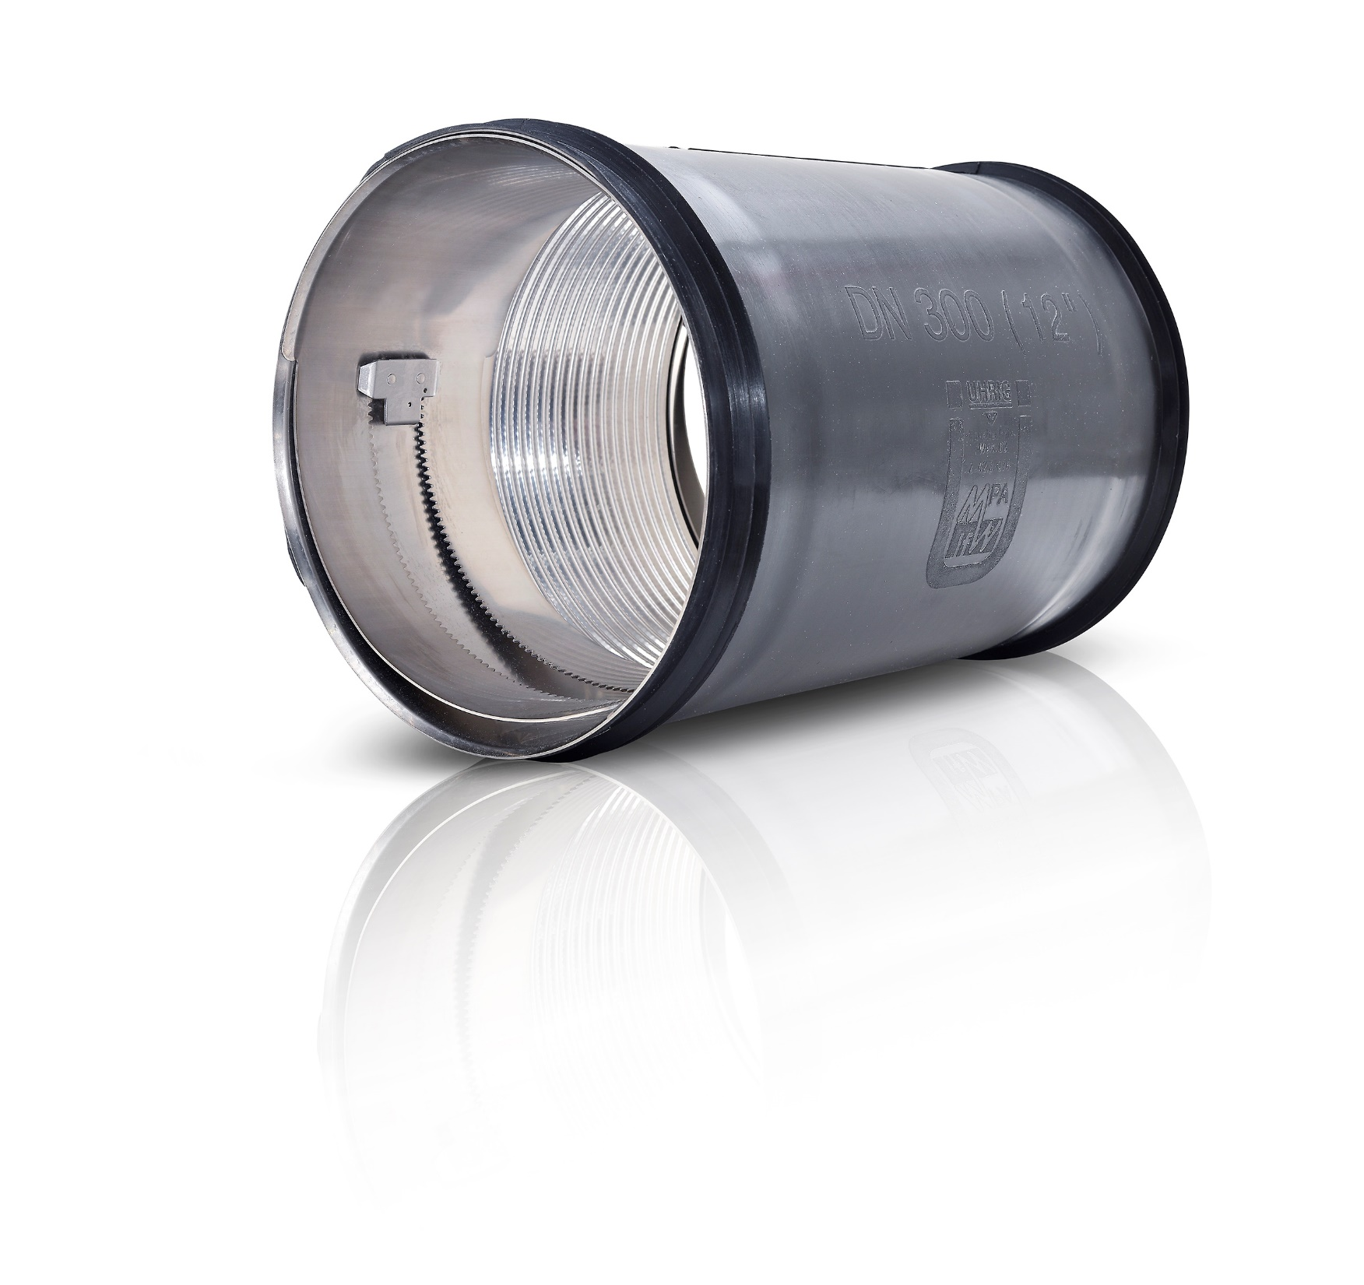
Quick-Lock Flex
Quick-Lock BIG
AND OTHER QL-SYSTEMS are available

Slide 17
Advantages over other systems
environmentally friendly - no waste on site
no construction chemicals needed
all over the year easily usable
force / form-fitting fixed to the wall
long life span - 50+ years design life
permanently elastic and tight
2 rows of teeth at each lock for added strength
3 gears: 2 gears run along teeth of sleeve and the 3rd gear prevents unlocking
teeth are positioned close together for a tight seal

Slide 18
statically stabilizing
dewatering only partially necessary
no cure times (safe times on site à economic efficiency)
first partial renovation system with a type statics for the AZ II
for partial AND serial installations
tested up to an external pressure of 1.5 bar = 15 m water column
longitudinal cracks and body formation up to an ovalization of 3-max5%
protect liner ends against damages from jetting and cleaning or crawler entry
incorporates the thickness of the liner
seals pipe end to keep infiltration from getting behind the liner
Quick-Lock Flex is designed to handle offsets
Quick-Lock (DN100 / 125 / 150 short) are designed to go thru bands and for rising mains
various approvals

Slide 19
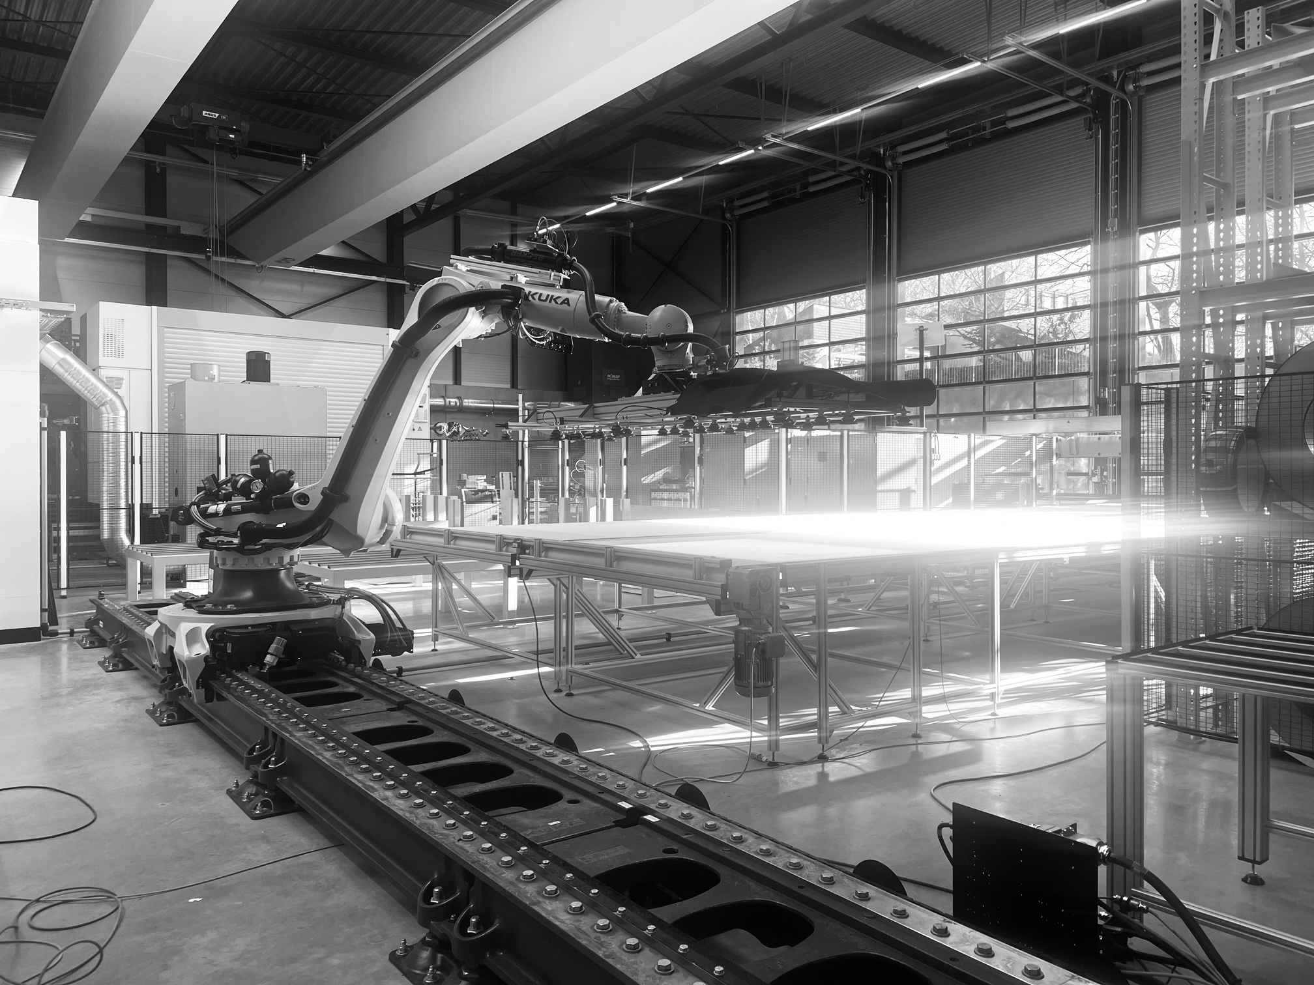
Thank you
for your
attention!
©Uhrig Kanaltechnik GmbH

